Slide 1
Calculating heat stress index from routine weather station data to model climate change impacts on worker productivity
Bruno Lemke, Tord Kjellstrom

Slide 2
Quantifying Climate Change
Climate change will increase temperatures in most places around the world in the coming decades. Temperatures in urban areas will go even higher due to the “heat island effect”. In order to measure the effect of climate change on worker productivity a heat stress index that incorporates temperature, humidity, wind speed and solar radiation is needed.

Slide 3
What Heat index to use?
Effective Temperature: CET, ET, NET, PET, SET
WBGT: most comprehensively studied
UTCI: for both hot and cold temperatures
ETVO: all components separately identified
Humidex: Canada
HI: USA
Comfort indexes: PMV
Physiological models: PHS, Fiala etc
Notes:
International Journal of lndustrial Ergonomics, 3 (1988) 89-102 89
HEAT STRESS INDICES: A REVIEW PAPER
Mohamed Youssef Beshir and Jerry D. Ramsey
Development of outdoor thermal index indicating universal and separate effects on human thermal comfort
Kazuo Nagano & Tetsumi Horikoshi Int J Biometeorol (2011) 55:219–227

Slide 4
The four environmental variables
You need an index that includes:
Temperature
Humidity
Wind speed
Solar radiation

Slide 5
Plus personal variables
Work rate
Clothing
Degree of acclimatisation
Level of hydration
Heat response sensitivity
  Age
  Health
  Gender
  Ethnic group
  Body area
  Obesity
Highly variable

Slide 6
Main contenders for heat index
UTCI: new index with laboratory validation
WBGT: older extensively field tested index
Many other indexes do not include all the climatic variables

Slide 7
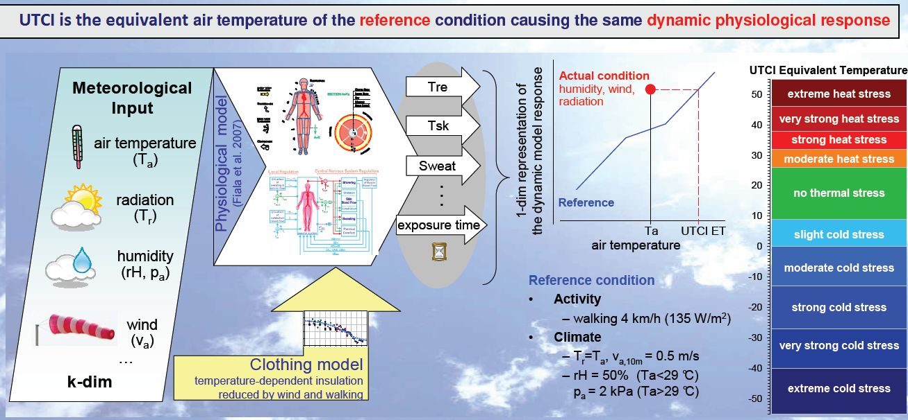
UTCI mathematical model
Notes:
Calculating UTCI equivalent temperatures Poster on www.utci.org

Slide 8
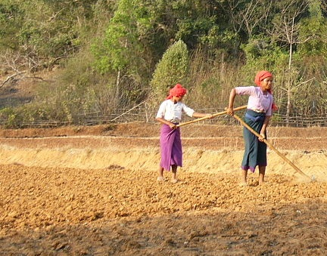
WBGT is a physical model
Heat stress is about losing heat mainly by sweating and by wind:

Slide 9

Simple model
Use a thermometer

Slide 10
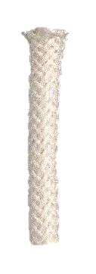

Simple model
Use a thermometer, add a wet wick

Slide 11
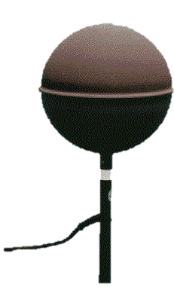
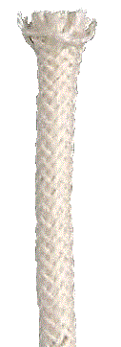
Add radiation= WBGT index
WBGT(indoor) = 0.7Tnwb + 0.3Ta
WBGT(outdoor) = 0.7Tnwb + 0.2Tg + 0.1Ta

Slide 12
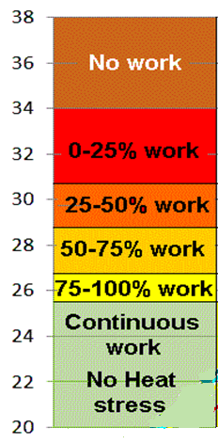
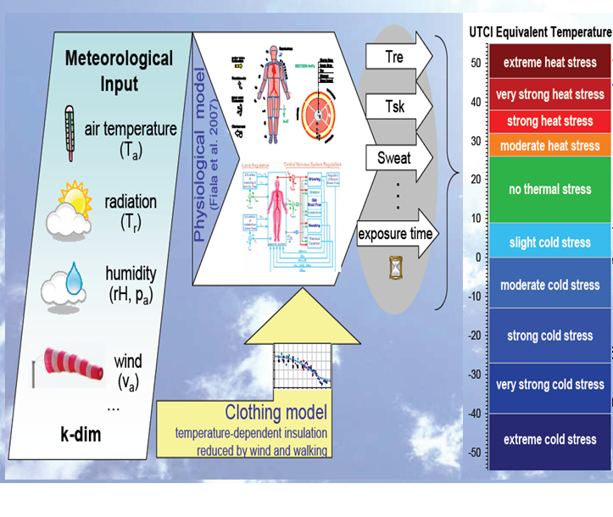
Which index would you use?
WBGT
UTCI

Slide 13
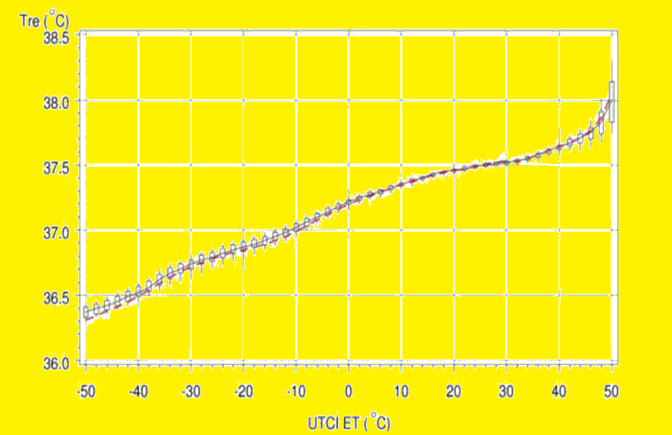
Where do we want accuracy?
Notes:
Proceedings of Conference: Adapting to Change: New Thinking on Comfort
Cumberland Lodge, Windsor, UK, 9-11 April 2010. London: Network for Comfort and Energy Use in Buildings, http://nceub.org.uk
The Universal Thermal Climate Index UTCI in Operational Use
Peter Bröde, Gerd Jendritzky, Dusan Fiala, George Havenith

Slide 14
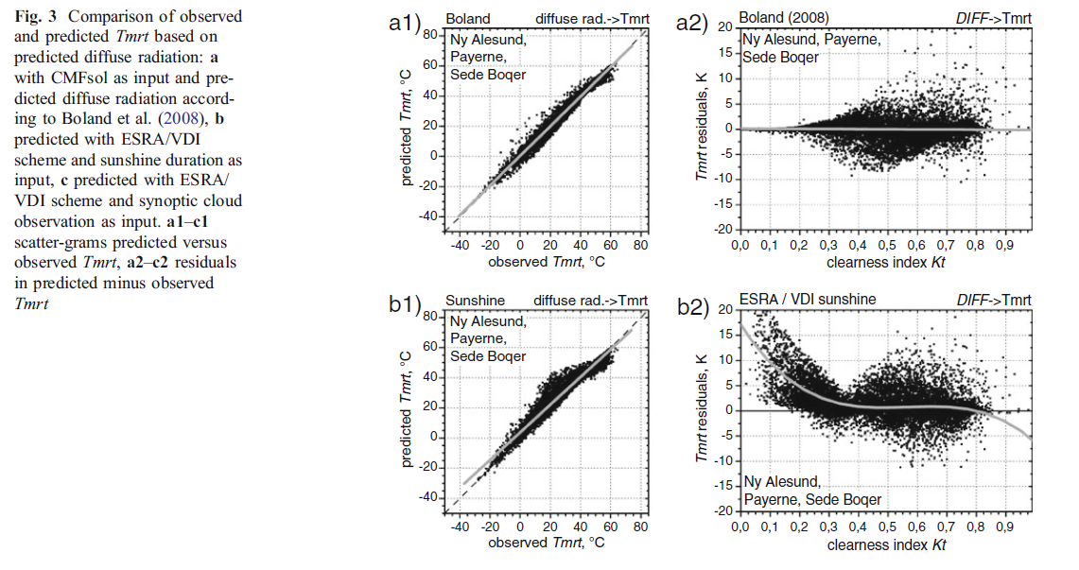
Mean Radiant Temperature
Notes:
Int J Biometeorology SPECIAL ISSUE (UTCI) Feb 2011
The uncertainty of UTCI due to uncertainties in the determination of radiation fluxes derived
from measured and observed meteorological data
Philipp Weihs & Henning Staiger & Birger Tinz & Ekaterina Batchvarova &
Harald Rieder & Laurent Vuilleumier & Marion Maturilli & Gerd Jendritzky

Slide 15
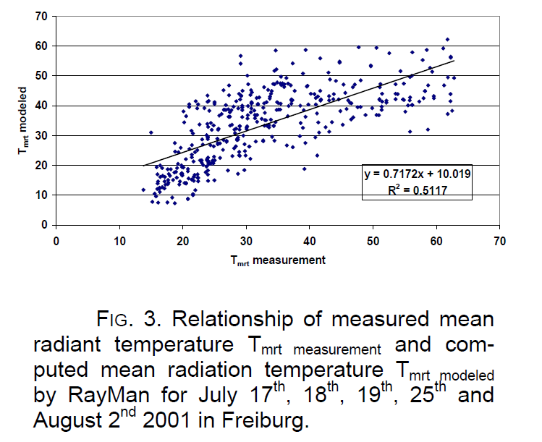
Mean Radiant Temperature

Slide 16
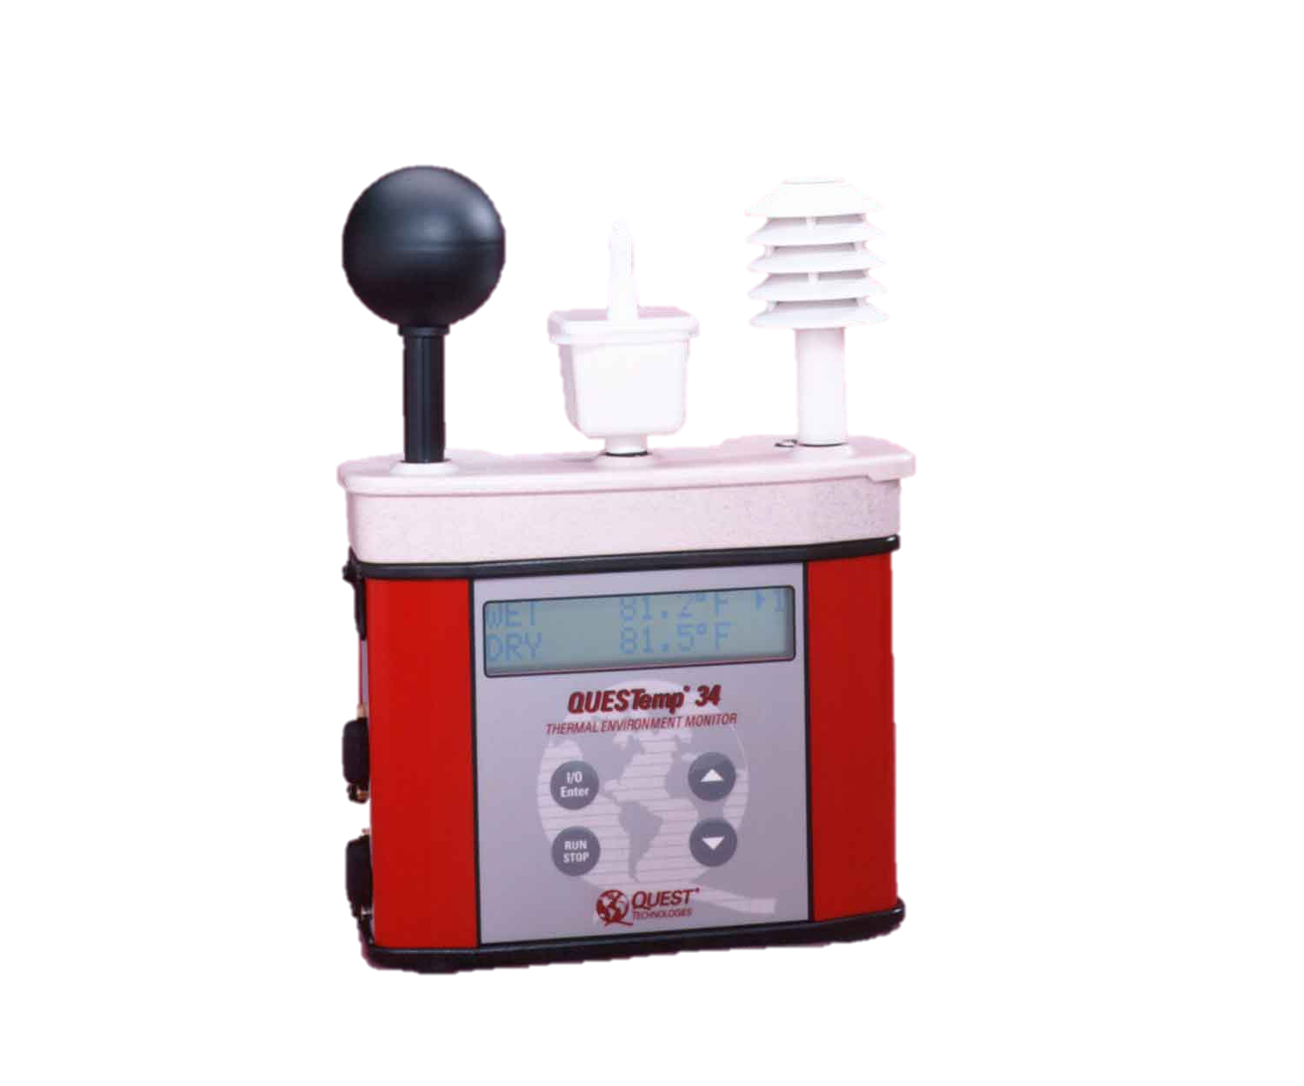
Advantages of WBGT
Easy to measure
A scale that has been around for ages so well tested heat stress standards
Contains all the environmental components without confounding them with personal variations

Slide 17
Issues with WBGT
Does not take into account physiological changes other than sweating.
  WBGT not suitable below heat stress levels.
WBGT not useful as such for historical data.

Slide 18
WBGT from meteorological data
We compare published models that generate the WBGT heat stress index from standard hourly weather station data.

Slide 19
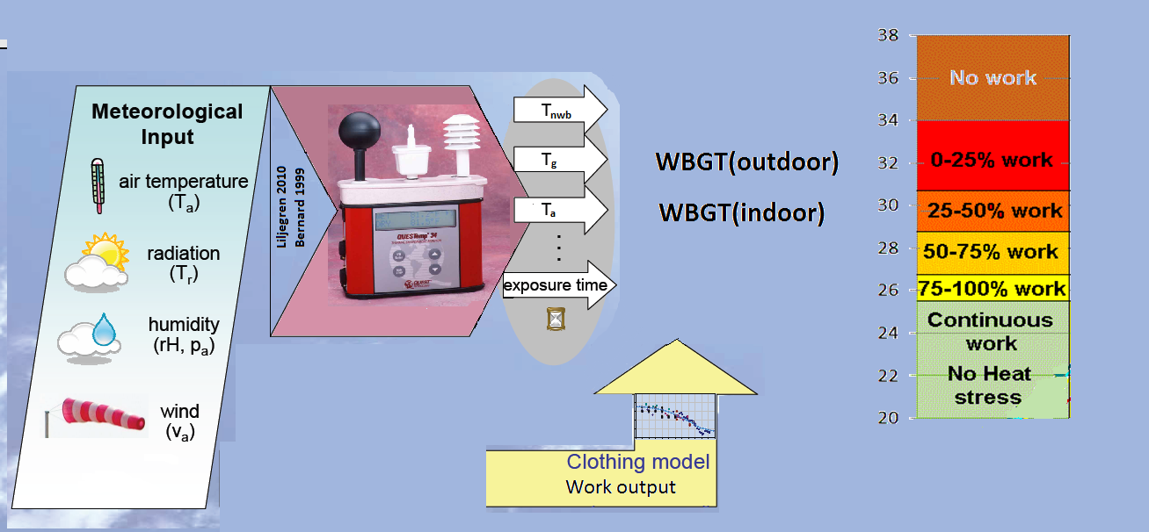
WBGT from meteorological data
Same process as working out heat gain/loss by people EXCEPT its less complicated.

Slide 20
WBGT from meteorological data
Some formulas only for indoors (Bernard)
Others are only for full sunlight (Gaspars).
Liljegren: "best formula" for outside conditions (both sun and clouds)
They freely supply a computer program.
  Liljegren et al (2008) “Modeling Wet Bulb Globe Temperature using Standard Meteorological Measurements” Journal of Occupational and Environmental Hygiene 5: 645-655
Notes:
Bernard TE, Pourmoghani M (1999) Prediction of Workplace Wet Bulb Global Temperature. Applied Occupational and Environmental Hygiene 14: 126-134
Liljegren J, Carhart R, Lawday P, Tschopp S, Sharp R (2008)
Modeling Wet Bulb Globe Temperature using Standard Meteorological Measurements
Journal of Occupational and Environmental Hygiene 5: 645-655
Gaspar A, Quintela D (2009) Physical modelling of globe and natural wet bulb temperatures to predict WBGT heat stress index in outdoor environments. International Journal Biometeorology 53: 221-230

Slide 21
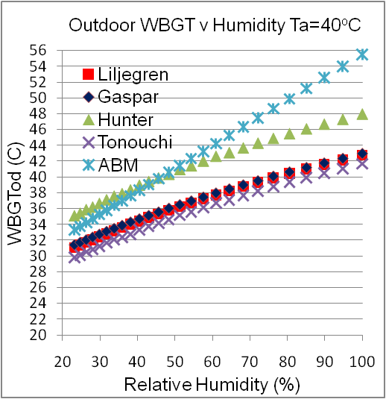
ABM is wrong
Notes:
Hunter C, Minyard O (1999) Estimating Wet Bulb Globe Temperature using Standard Meteorological Measurements. Report WSRC-MS-99-00757 . Westinghouse Savannah River Company, Aiken, SC
ABM (2009) About the WBGT and Apparent Temperature Indices. Bureau of Meteorology, Commonwealth of Australia, Melbourne, Website. http://www.bom.gov.au/info/thermal_stress/. Accessed June 2011
Tonouchi M, Murayama K, Ono M (2006) WBGT Forecast for Prevention of Heat Stroke in Japan. Sixth Symposium on the Urban Environment. AMS Forum: Managing our Physical and Natural Resources: Successes and Challenges JP1.1

Slide 22
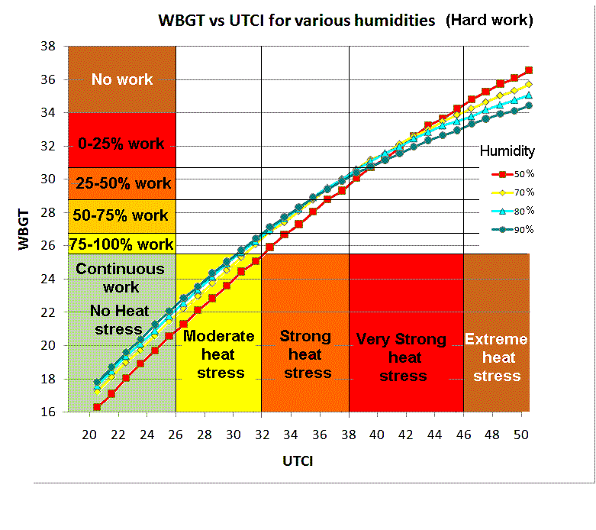
Notes:
ISO (1989) Hot environments - Estimation of the heat stress on working man, based on the WBGT-index (wet bulb globe temperature). ISO Standard 7243. International Standards Organization, Geneva.

Slide 23
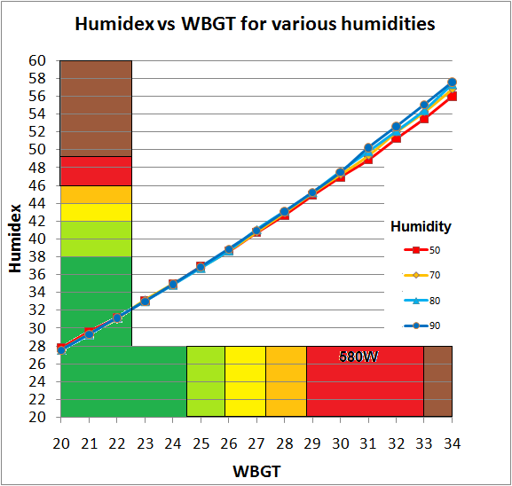
Continuous work 0-25% 25-50% 50-75% 75-100% no
rest rest rest rest work

Slide 24
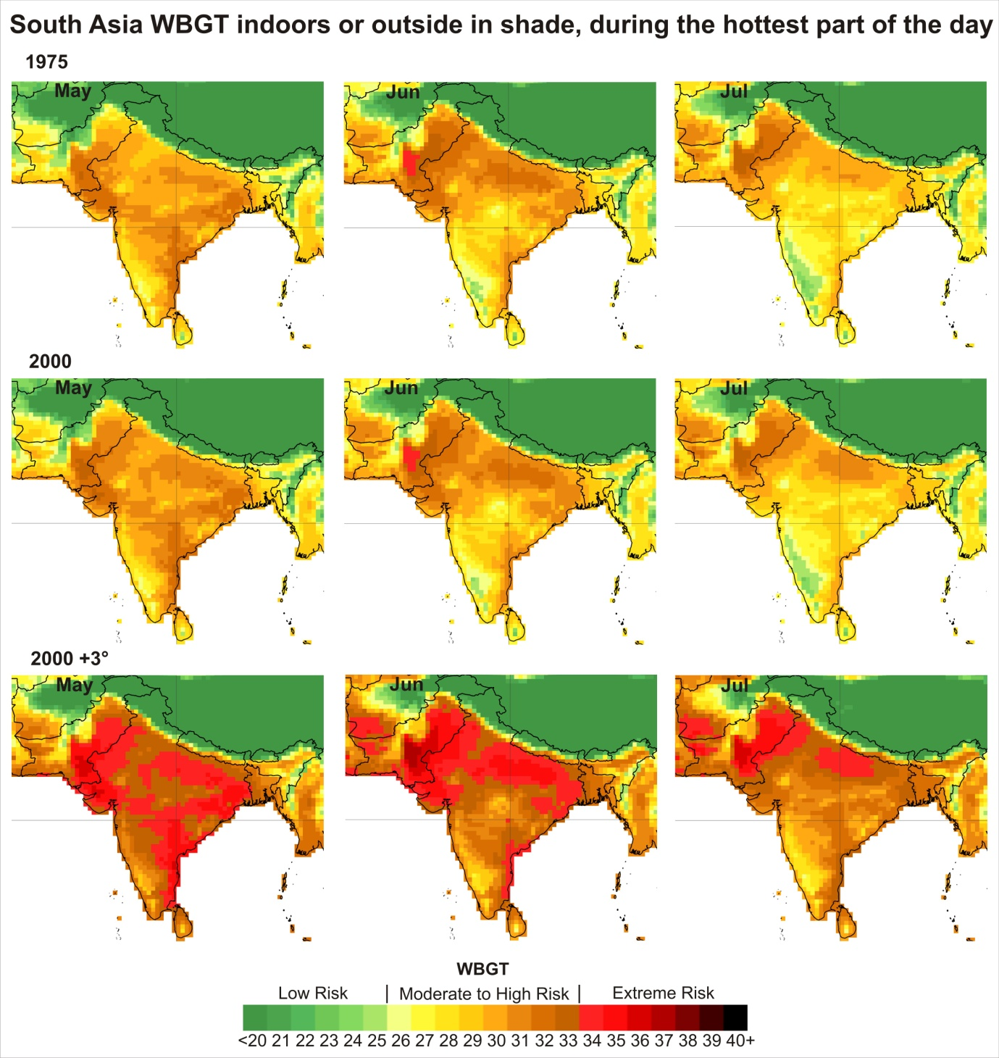

Slide 25
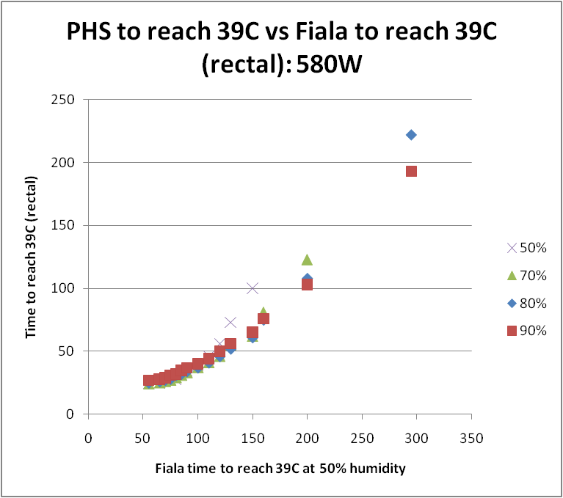
PHS(Bernard) vs Fiala

