Slide 1
Heat Stress Now and in the Future: focus on health & productivity of rural workers
Bruno Lemke & Tord Kjellstrom
NMIT Nelson New Zealand,
United Nations University, International Institute of Global Health, Kuala Lumpur, Malaysia
Lund University, Pufendorf Institute, Lund Sweden

Slide 2
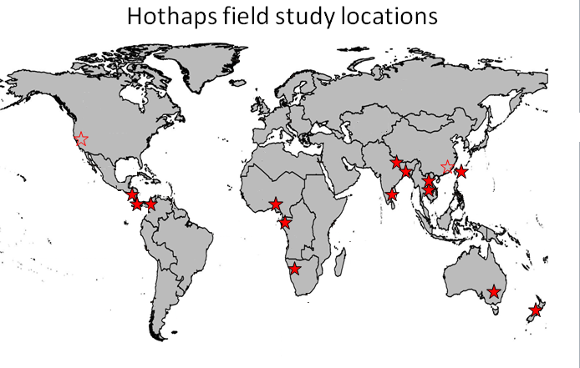
High Occupational Temperature: Health and Productivity Suppression

Slide 3
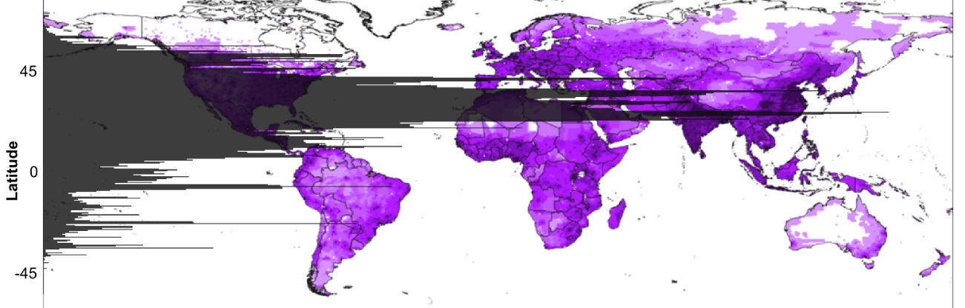
Heat is a big killer
USA extreme weather deaths 1979-2006
Category | Deaths | Annual Mean | Deaths %
Excess cold | 18,828 | 697 | 50%
Excess heat | 10,176 | 377 | 27%
Floods | 2,691 | 100 | 7%
Lightning | 2,289 | 85 | 6%
Hurricanes | 2,069 | 77 | 6%
Tornados | 1,514 | 56 | 4%
Under-estimation
Differs by state
Where is the world population?
Notes:
I M. Goklany Journal of American Physicians and Surgeons Volume 14 Number 4 Winter 2009

Slide 4
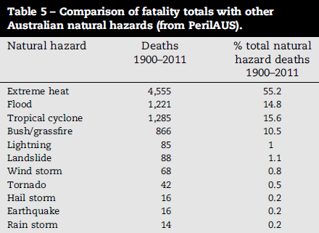
Deaths in hotter countries
Notes:
Exploring 167 years of vulnerability: An examination of extreme heat events in Australia 1844–2010 Lucinda Coates, Katharine Haynes, James O’Brien, John McAneney, Felipe Dimer de Oliveira Environmentalscience & Policy 42 ( 2014 ) 33 – 44

Slide 5
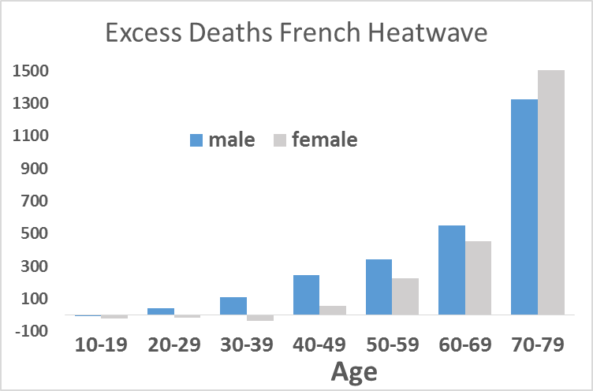
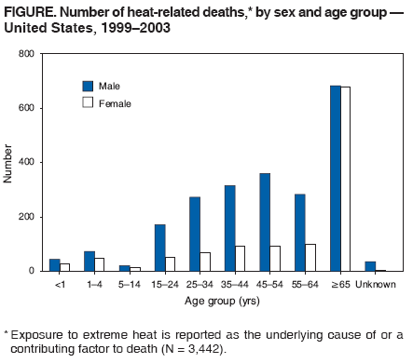
Dying from heat?
2003 French Heatwave Excess Deaths
Age | male | female
0-9 | -3 | -20
20-29 | 40 | -16
30-39 | 109 | -35
40-49 | 246 | 58
50-59 | 343 | 228
60-69 | 551 | 456
70-79 | 1326 | 1888
80-89 | 1849 | 3593
90 & over | 759 | 3371
WBGTmax(shade) < 29C
Notes:
The Mortality Impact of the August 2003 Heat Wave in France
Laurent Toulemon and Magali Barbieri Paper prepared for presentation at the 2006 Population of America Association Meeting, Los Angeles, March 30-April 1st.
Morbidity and Mortality Weekly Report. Centers for Disease Control and Prevention, Heat-Related Deaths --- United States, 1999—2003
http://www.cdc.gov/mmwr/preview/mmwrhtml/mm5529a2.htm#top

Slide 6


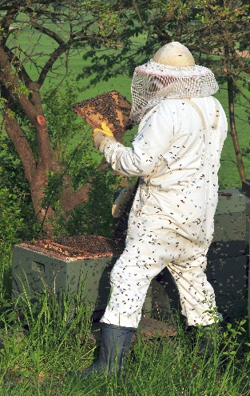
Who is more at risk of heat strain?
(same temperature)
Worker: I’m feeling hot, dizzy and nauseous
Supervisor: Drink plenty of water. That will allow you to sweat more to cool you down.

Slide 7
Effect of physical work on core temperature
1
2
3
Recommended maximum work load for a 8-8.5 h working day with pauses
by 1) WHO, 2) Andersen and 3) Rutenfranz
Notes:
Astrand, P.-O. and Rodahl, K. 1977. "Textbook of Work Physiology". New York, McGraw Hill, 2nd. ed.

Slide 8
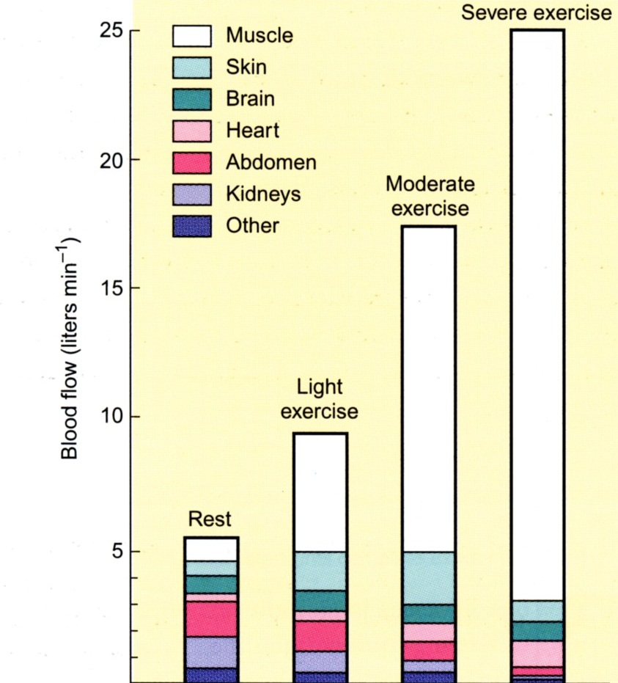
Effect of physical work on blood flow
Hannu Rintamäki
Performance and Productivity in the Heat HOTHAPS seminar 8/11/2011
Notes:
Astrand, P.-O. and Rodahl, K. 1977. "Textbook of Work Physiology". New York, McGraw Hill, 2nd. ed.

Slide 9
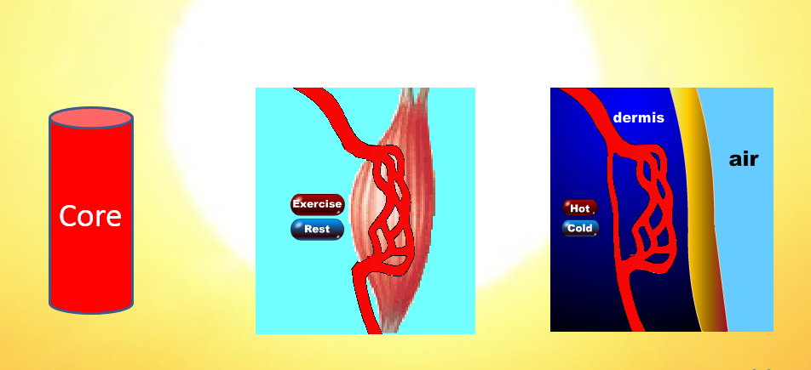
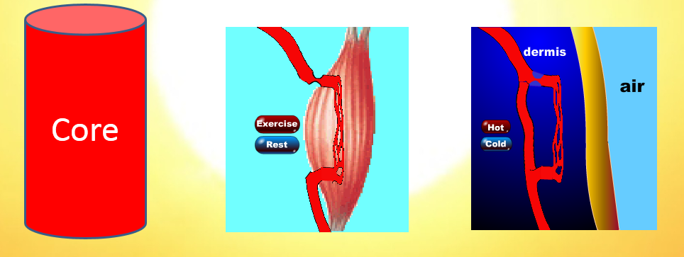
Where blood is needed
Interplay between muscle supply, temperature control and core blood volume.

Slide 10
Heat Strain/Stroke
Characteristics | Classic | Exertional
Age | Young & Elderly | 15-55 yr
Health | Unwell | Healthy
Weather | Heatwaves | Hot weather
Activity | Sedentary | Strenuous Exercise
Sweating | Absent | High
Renal Failure | Uncommon | Common
Rhabdomyolysis | Uncommon | Common
Hyperkalaemia | Uncommon | Common
Hypoglycaemia | Uncommon | Common
Enzymes in blood | Uncommon | Common
Winkenwerder & Sawka. Cecil’s Textbook of Medicine 2007

Slide 11
Heat Exposure: USA farmworkers NCFH, March 2013
Between 1993 and 2008, 423 workers in agricultural related industries died from heat exposure. 67% of those fatalities were workers employed in crop production sectors.
MMWR 2008.
Notes:
National Center for Farmworker Health http://www.ncfh.org/docs/fs-Occ%20Health.pdf
Luginbuhl, RC., et al. (2008). Heat-Related Deaths Among Crop Workers--- United States, 1992-2006. Morbidity and Mortality Weekly Report, 57 (24), p. 649-653.

Slide 12
Heat Exposure: USA farmworkers
NCFH, March 2013
A study of 300 farmworkers in North Carolina:
94% reported they had worked in extreme heat.
40% reported having had symptoms of heat illness.
Notes:
National Center for Farmworker Health http://www.ncfh.org/docs/fs-Occ%20Health.pdf
Luginbuhl, RC., et al. (2008). Heat-Related Deaths Among Crop Workers--- United States, 1992-2006. Morbidity and Mortality Weekly Report, 57 (24), p. 649-653.

Slide 13
Heat Exposure: India
In 1998 in Orissa (region in India) an unprecedented heat wave killed 2042 people. Though extensive awareness campaigns have largely reduced the number of casualties since 1998, still a good number of casualties are being reported each year. Mostly poor people, farmers and workers die from sunstroke.
Notes:
http://www.osdma.org/ViewDetails.aspx?vchglinkid=GL002&vchplinkid=PL008
Odesha state Department Disaster Management Authority

Slide 14
Workers, the Climate Canaries
Editorial: American Journal of Public Health 2014
The current regulations are inadequate for protecting the most vulnerable workers such as farm workers and public employees. Immigrant workers, workers on piece work pay, day by day labor schemes, without sick days, in remote work locations, with limited regulatory oversight, on low wages are heavily represented in occupations likely to be affected by climate change.
Notes:
Editorial: American Journal of Public Health October 2014, Vol 104, No. 10

Slide 15
Impact of heat on Rural Workers
Considerable undercounting (Univ California study)
Migrant workers in USA are at special risk on hot farm fields, as their rest periods cost them money
In tropical countries the heat exposures and reluctance to rest are even worse
This global health hazard will undermine efforts to reduce poverty.
  low & middle income countries to loose 2-8% of GDP in 2030 from increasing workplace heat. 2012 DARA report
Notes:
AgHealth News Summer 2014 Vol. 23, No. 3 Western Center for Agricultural Health and Safety • University of Cal ifornia, Davis ,
http://www. annalsofepidemiology. org/article/S1047- 2797(14)00012-X/
DARA report 2012 Climate Vulnerability monitor http://daraint.org/climate-vulnerability-monitor/climate-vulnerability-monitor-2012/report/

Slide 16
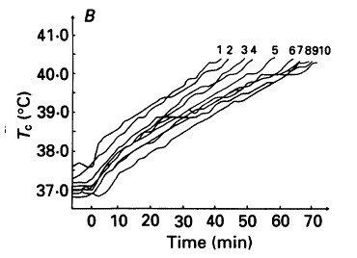
Get used to it?
Acclimatization: Change in core temperature with exercise to exhaustion over 10 days
Why might heat stress be an issue in Canada? or USA farmers?
Acclimatised works only to a point!
Notes:
Oesophageal temperature plotted against time for one acclimating subject during 10 consecutive days of exercise till exhaustion at 40C
Nielsen B, Hales JRS, Strange S, Christensen NJ , Warberg J, Saltin B Human Circulatory and Thermoregulatory Adaptations with Heat Acclimation and Exercise in a hot, dry Environment. Journal of Physiology (1993) 460 pp467-485

Slide 17
Important factors in heat stress
Environmental:
  temperature, sun, wind, humidity
Personal:
  clothes, work intensity, rest conditions, hydration level, acclimatisation
Individual:
  age, health, ethnicity, obesity……..

Slide 18
Temperature or Humidity?
Up to about 35C, ambient temperature plays a large role in losing excess body heat.
Above 35C, humidity becomes all important.
Low humidity: up to 1.5L fluid produced/hr which can then all evaporate to cool
High humidity: water still lost (dripping from body) but less evaporation so less cooling.

Slide 19
Evaporation of sweat
At 37C and 30% RH and some wind (apparent wind) the body can lose up to 600W of heat by evaporation alone.
This reduces to 160W at 80% humidity

Slide 20
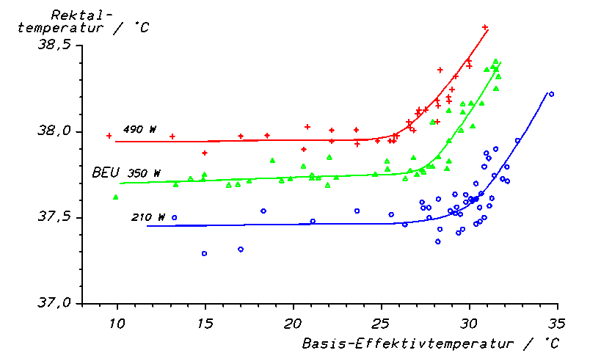
Compensable Heat Strain
Heat gained from work = Heat lost to environment
Core temperature remains constant
Notes:
Lind AR A Physiological criterion for setting thermal environmental limits for everyday work J Appl Physiol 18 51-56 (1963)

Slide 21
Uncompensable Heat Strain
Heat gained from work = Heat lost to environment
Core temperature remains constant
Heat gained = Heat lost + stored heat
Stored heat leads to rise in body temperature
Notes:
Lind AR A Physiological criterion for setting thermal environmental limits for everyday work J Appl Physiol 18 51-56 (1963)

Slide 22
What about stored heat?
Heat NOT able to be lost to environment leads to increase in body temperature.
Temperature increase can be calculated from person’s specific heat and mass.
For an 80 kg male doing heavy (400W) work @ 37C and 80% RH, what is his core temperature after 1 hour?
37C → 38C → 39C → 40C → 40.4C

Slide 23
Preventing heat stress in workers
Best way to reduce heat stress is reduce the work you do!!
Have limits (ISO standards)
Self pace so person naturally works less hard when it gets hotter.
Down side: less work gets done (safely)

Slide 24
How do you know to self pace?
Strong drivers NOT to self pace
Can you sense wind, sun, temperature, humidity?
sensitive, sensitive, less sensitive, insensitive
Best way to sense humidity?
is the person wet?
Any wet clothes or skin is a potential problem
Above 35C if no evaporation = no heat loss
Need a heat stress measure.

Slide 25
Heat stress indexes
Dozens of heat stress indexes
Combine environmental factors with some personal factors to give a measure of total heat stress.
They are never going to be correct because you are reducing a multidimensional effect to a one dimensional parameter

Slide 26
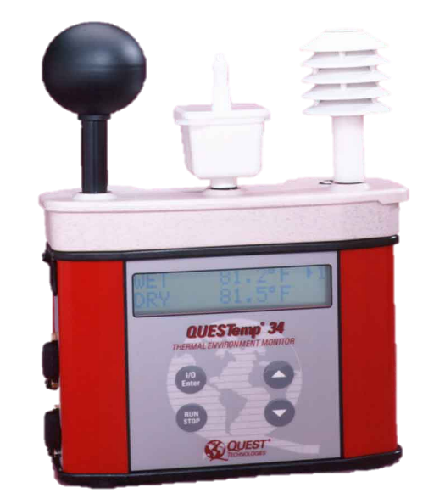
Measurement of Heat Stress
Environmental only:
  Indoors: Humidex, Heat Index (no sun or wind)
  Indoors/Outdoors: WBGT (work & clothes as extras)
Environmental and personal:
  UTCI, ET*, include work and clothes in calculation
  Large individual differences like health, ethnicity, obesity, genetics are not included!
Advantage of WBGT: more flexible
Advantage of UTCI: more rational

Slide 27
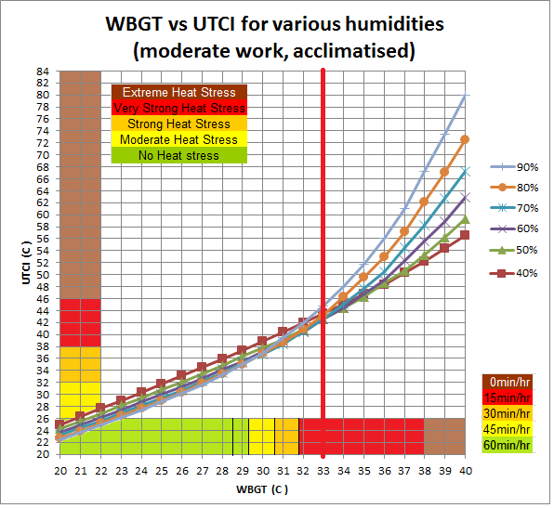
All models can be interlinked
Lemke B, Kjellstrom T Calculating workplace WBGT from meteoro-logical data: a tool for climate change assessment. Ind. Health. 2012;50(4):267-78.

Slide 28
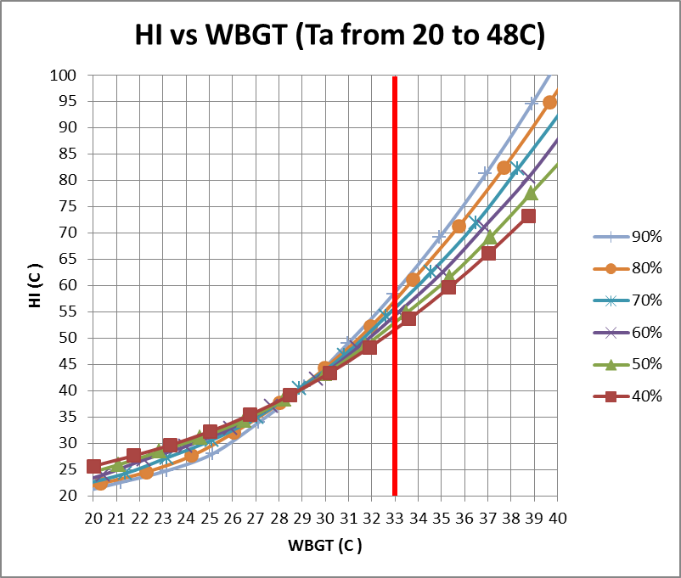
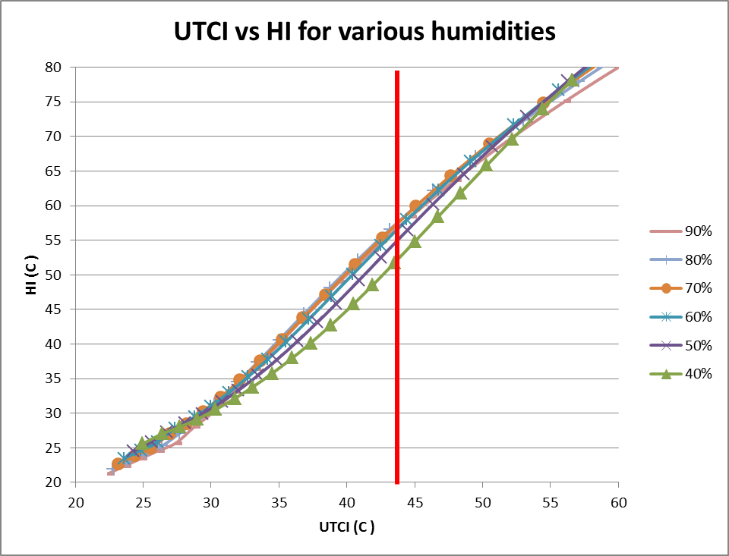
All models can be compared
HI better related to UTCI

Slide 29
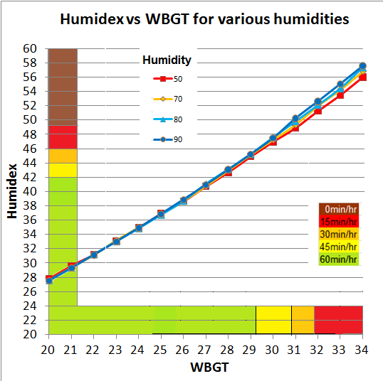
All models can be compared
Humidex related to WBGT @ 300W work

Slide 30
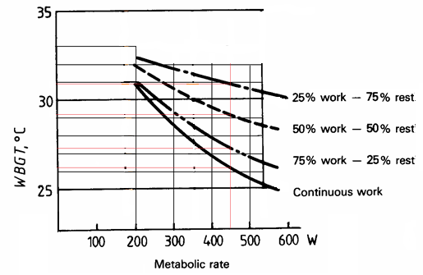
What does this mean for workers
WBGT measured then effect of clothes & work intensity added via ISO 7243
←Acclimatised
Not Acclimatised
Decrease WBGT by:
1 to 250 W
2 to 350W
3 to 450W
5 over 450W

Slide 31
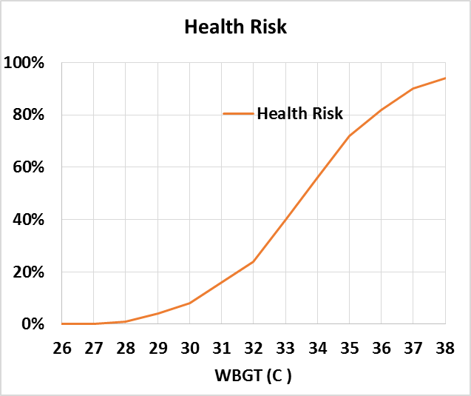
Balancing health & productivity
When WBGT goes up and the worker does not reduce physical labor serious health risks (heat stroke) increase.

Slide 32
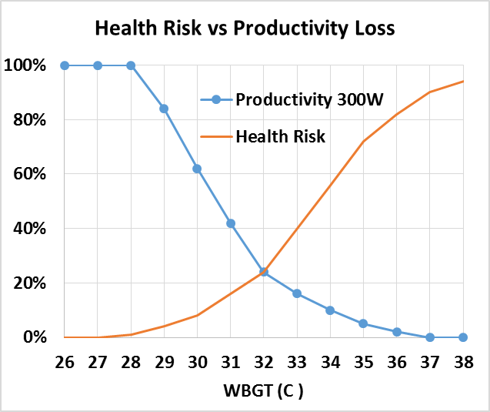
Balancing health & productivity
When WBGT goes up and the worker does not reduce physical labor serious health risks (heat stroke) increase.
When WBGT goes up and physical labor is reduced in line with occupational health standards, worker productivity goes down.
(Politics)

Slide 33
Future predictions of heat stress:
CMIP5 climate models downscaled to 0.5ºX0.5º.
Climate variability: only 30 year averages meaningful.
Monthly averages work in the tropics where the temperature does not change much during a month
In temperate zone there are some cool days reducing monthly averages but NOT the heat stress (non-linear)
Standard deviations are needed.

Slide 34
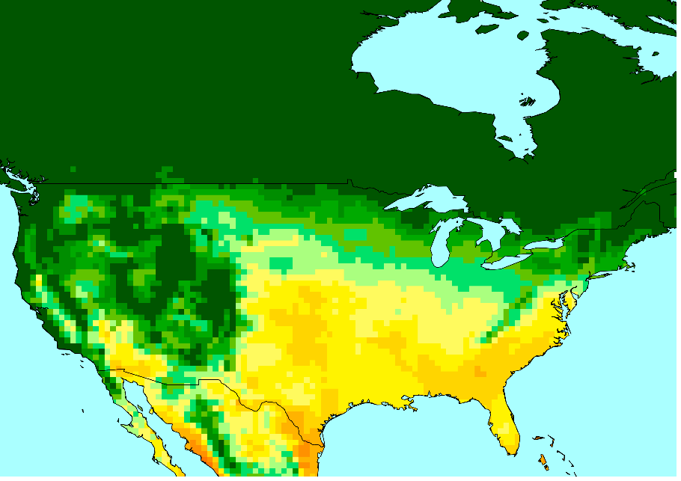
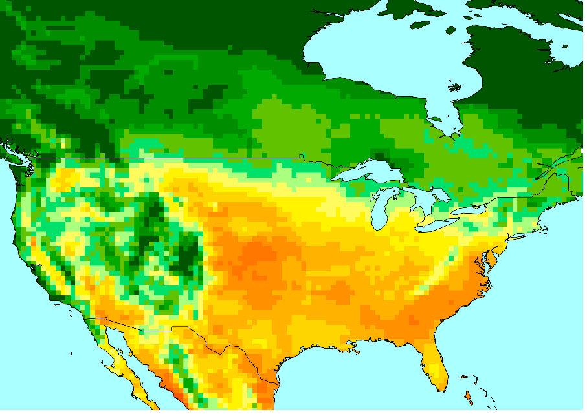
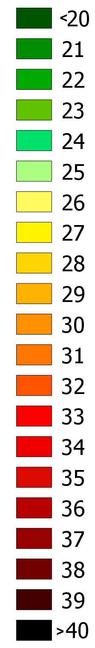
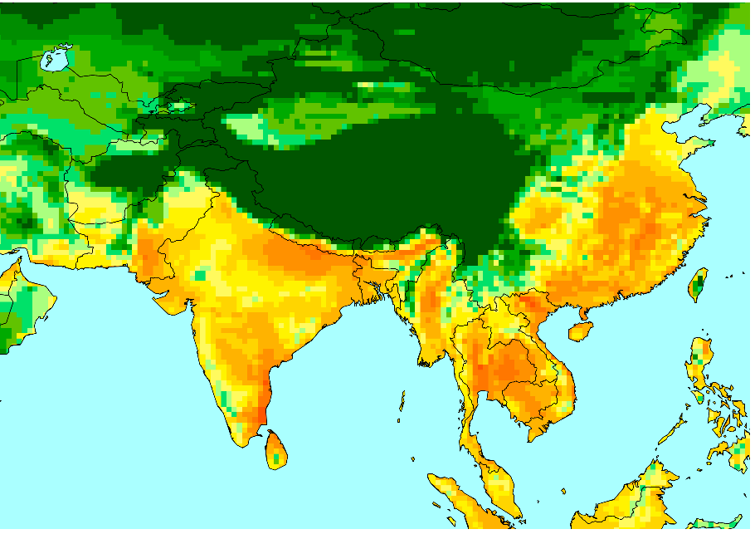
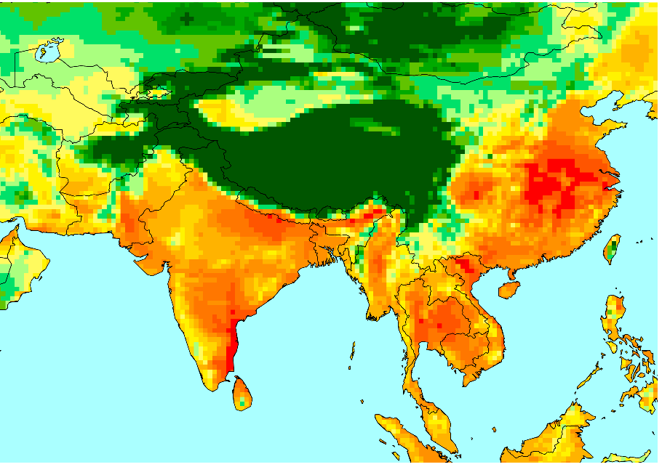
WBGTmax shade July 1995 GFDL model
Monthly 30 year mean Hottest 3 day 30 yr mean

Slide 35
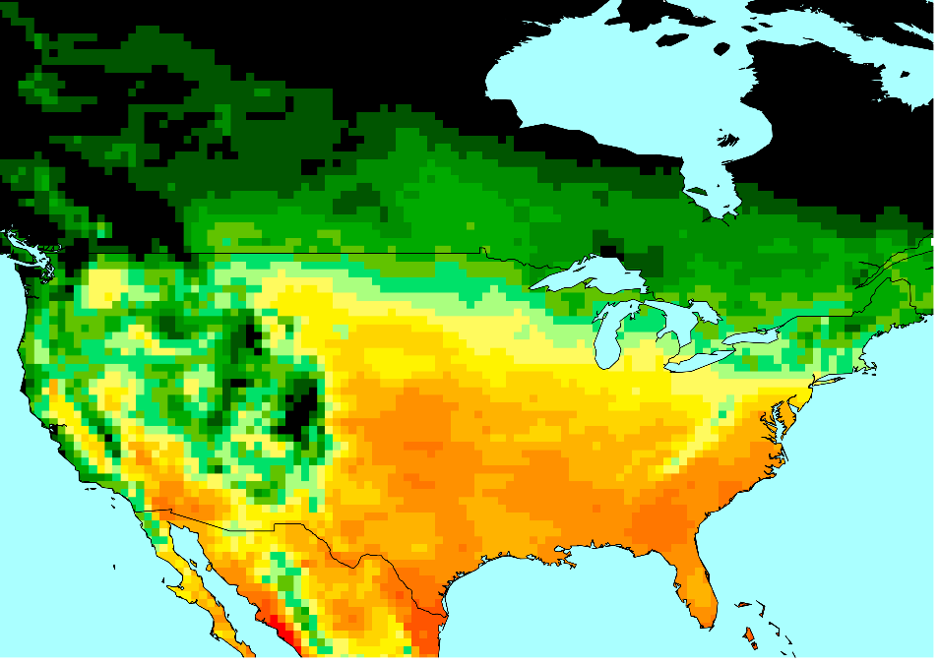
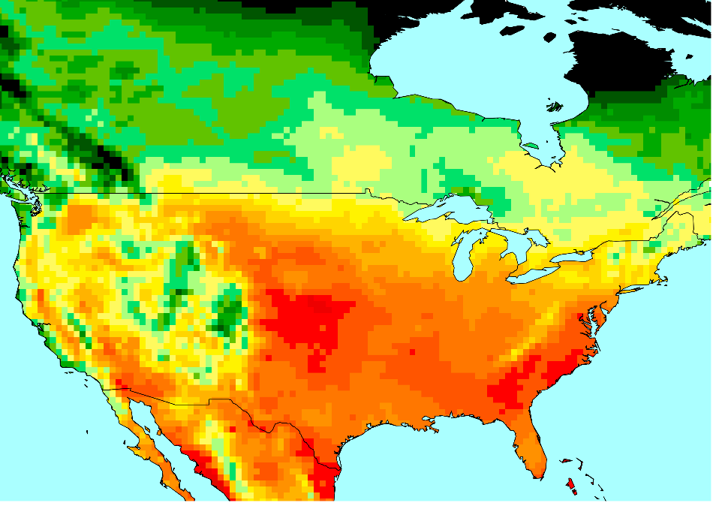
What about the sun?
WBGTmax GFDL
← Shade
↙↓ Sun
← Month ave
July 30 year mean July hottest 3 days

Slide 36
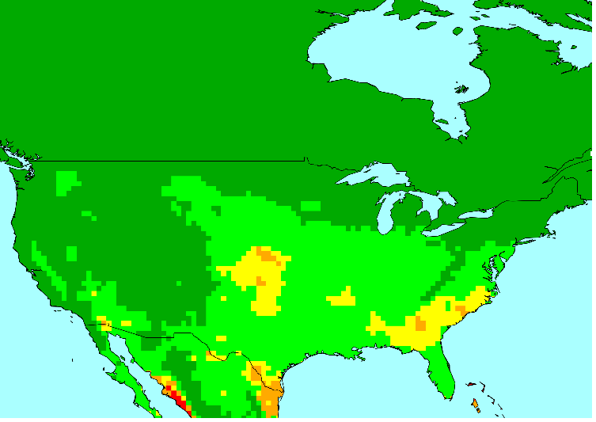
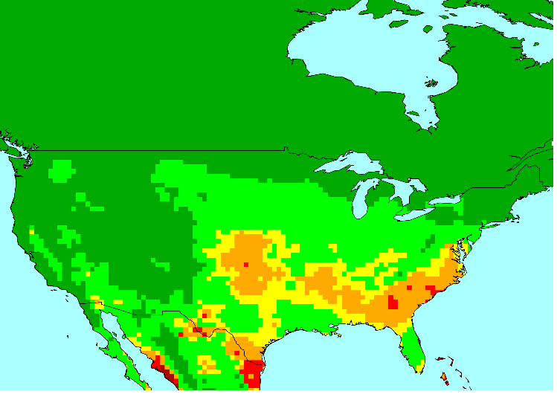
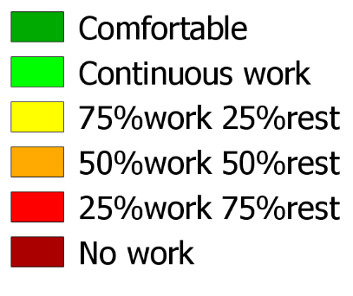
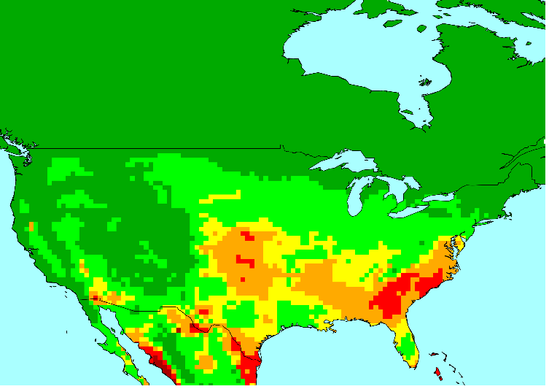
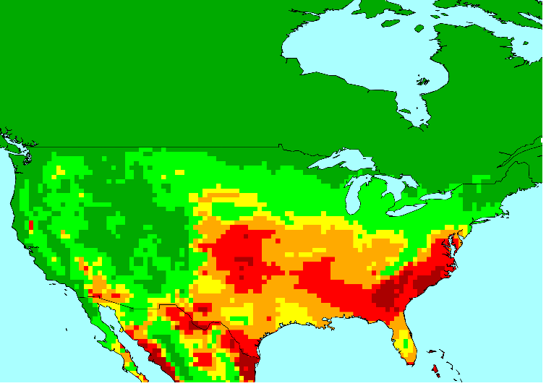
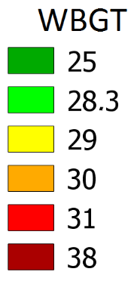
Productivity Loss
1995
2025
July, hottest 7 days, hottest 4 hours in shade, 300W productivity loss, ACGIH work conditions. GFDL rcp 6.0
2055
2085

Slide 37
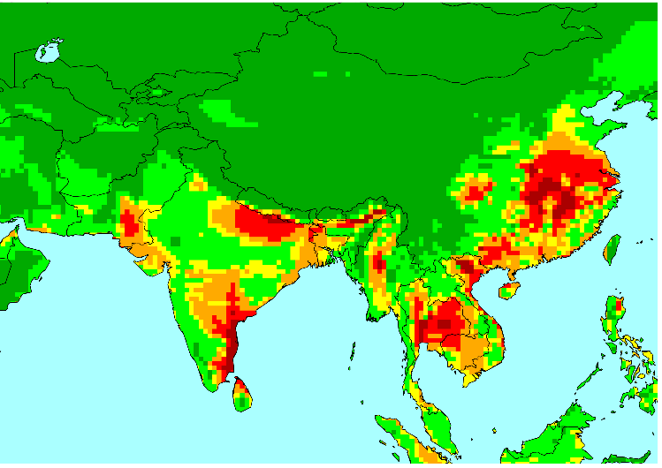
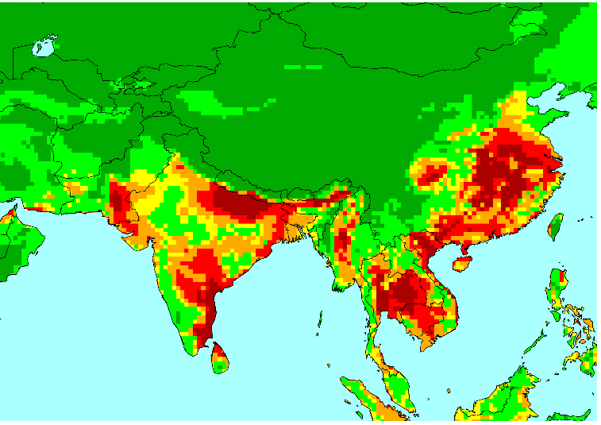
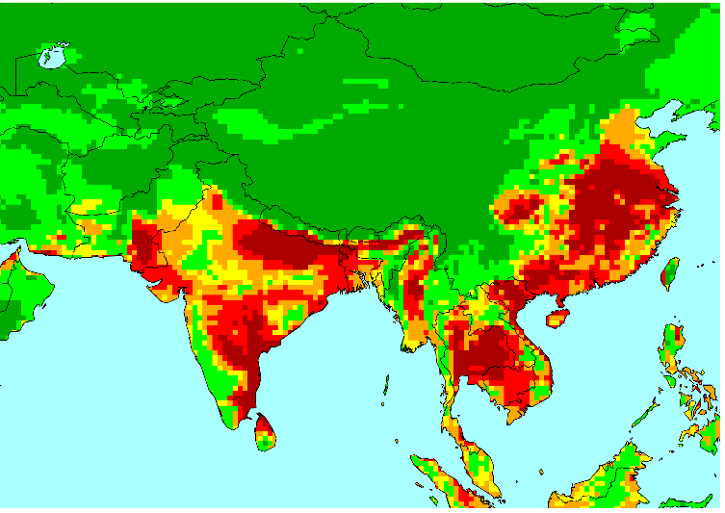
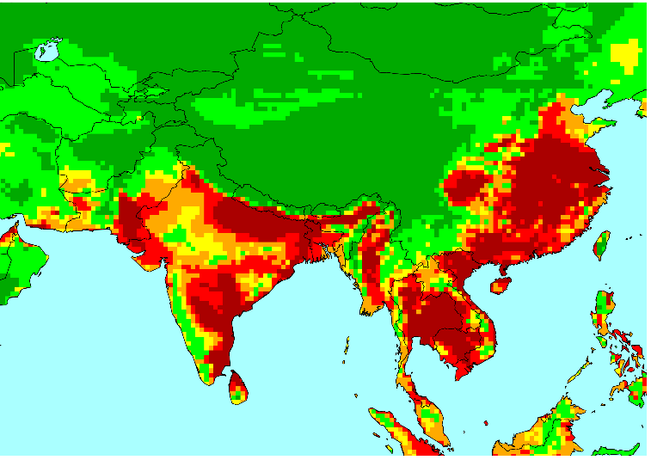
Productivity Loss
1995
2025
July, hottest 7 days, hottest 4 hours in shade, 300W productivity loss, ACGIH work conditions. GFDL rcp 6.0
2055
2085

Slide 38
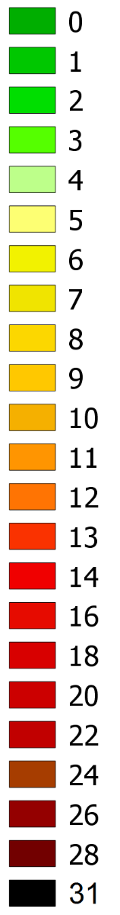
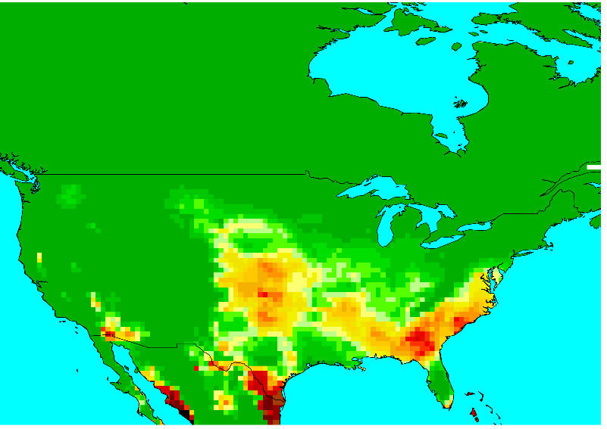
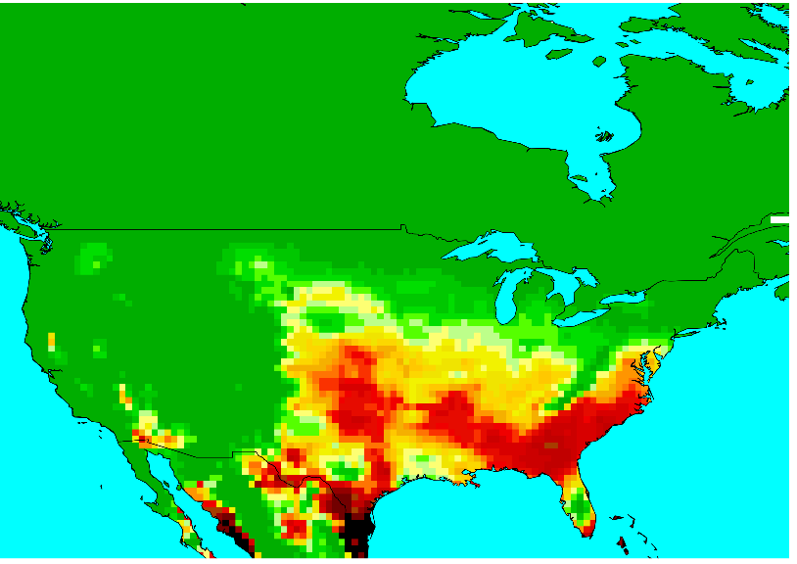
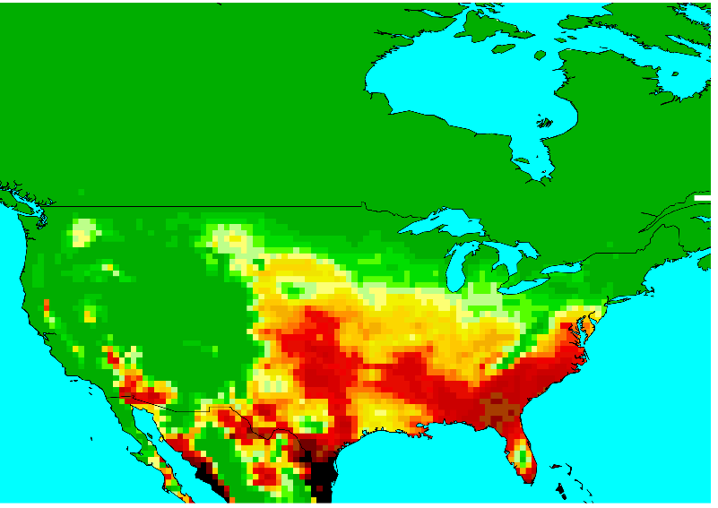
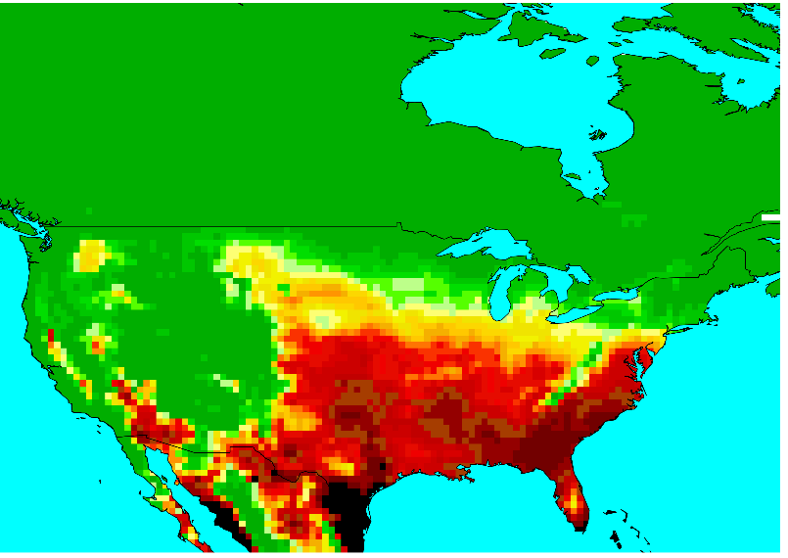
No. days where WBGTmax>28C
1995
2025
Number of July days where WBGTmax (shade) > 28C = reduce 300W work. GFDL model rcp 6.0
2055
2085

Slide 39
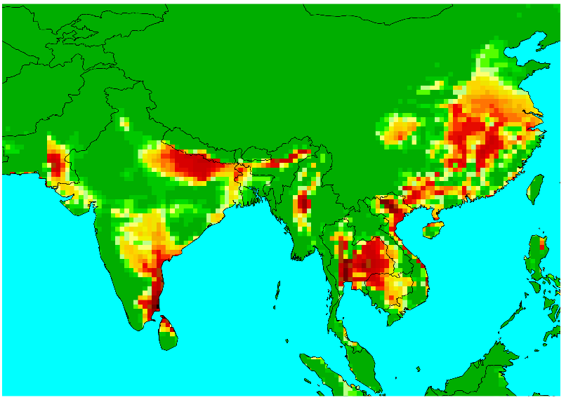
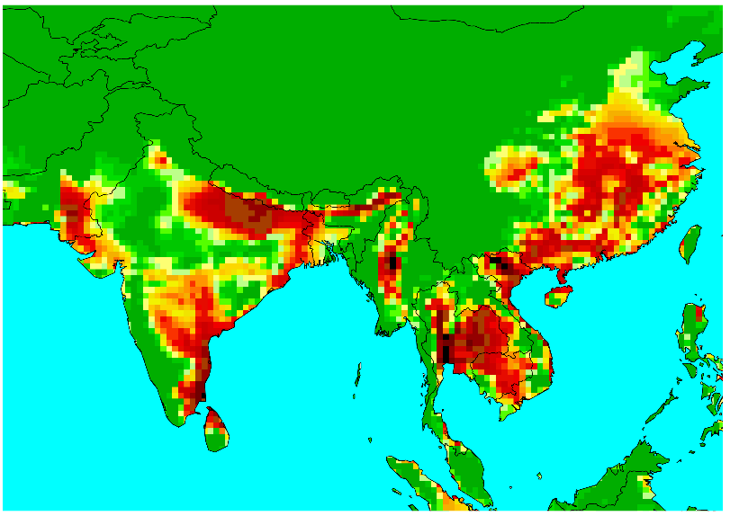
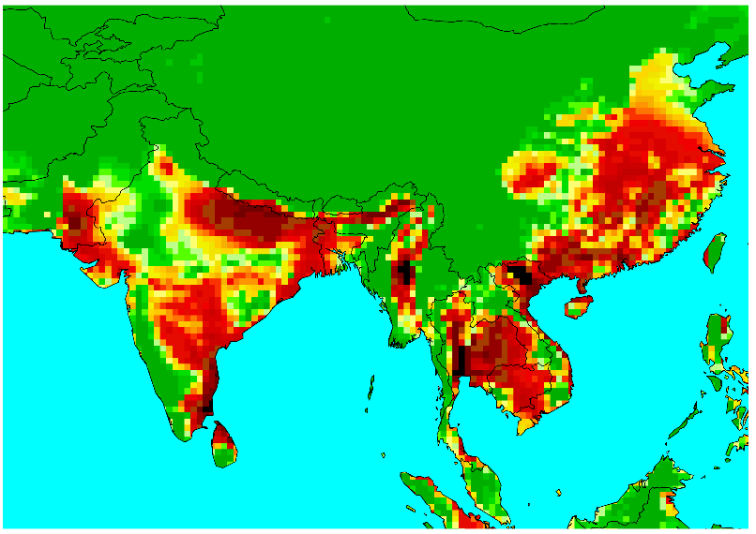
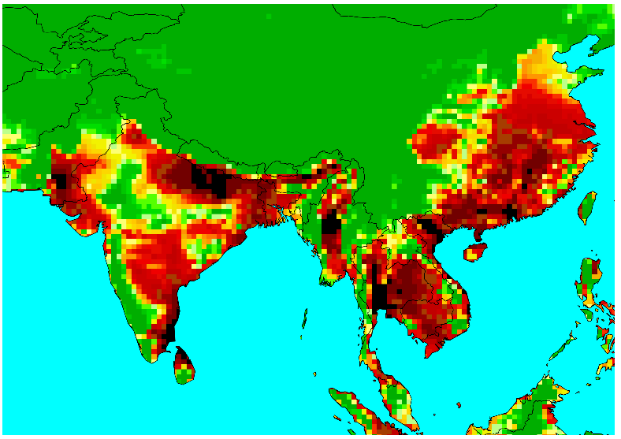
No. days where WBGTmax>28C
1995
2025
Number of July days where WBGTmax (shade) > 28C = reduce 300W work. GFDL model rcp 6.0
2055
2085

Slide 40
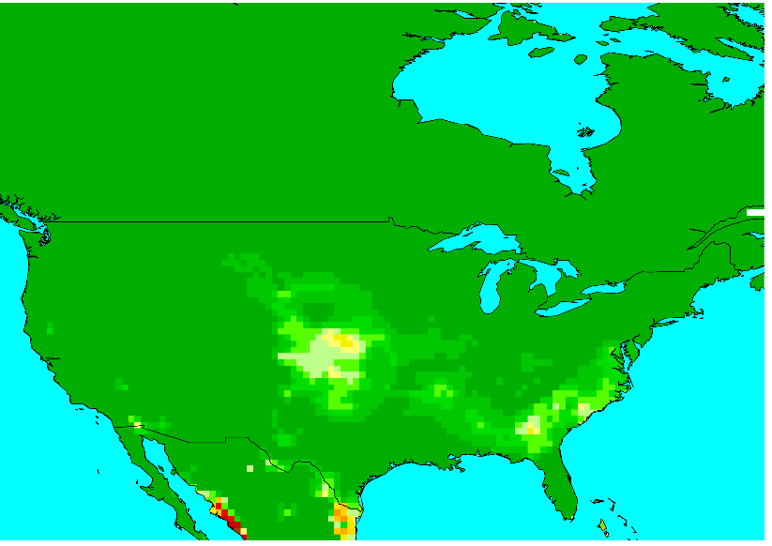
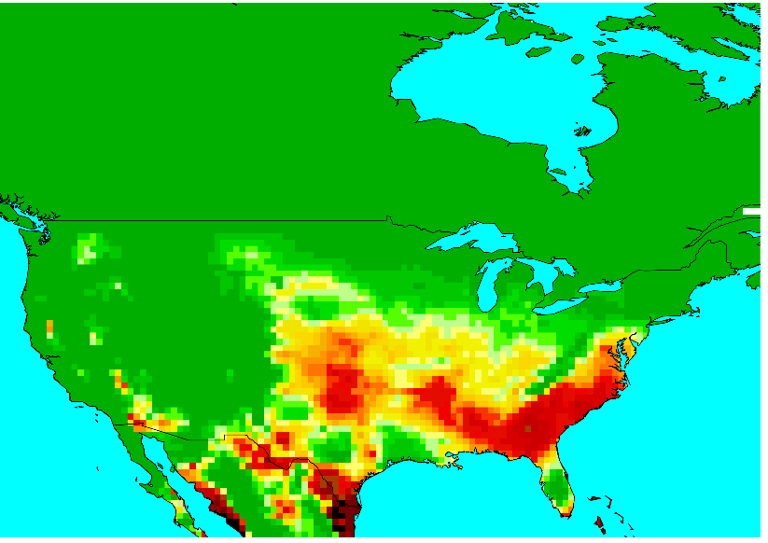
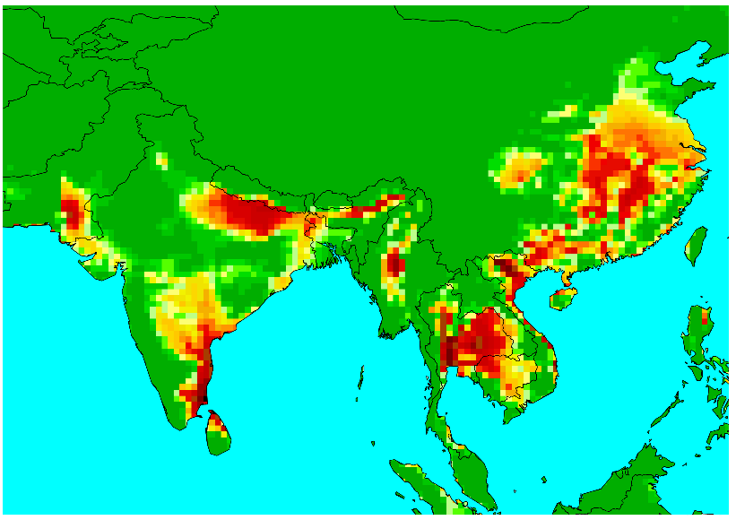
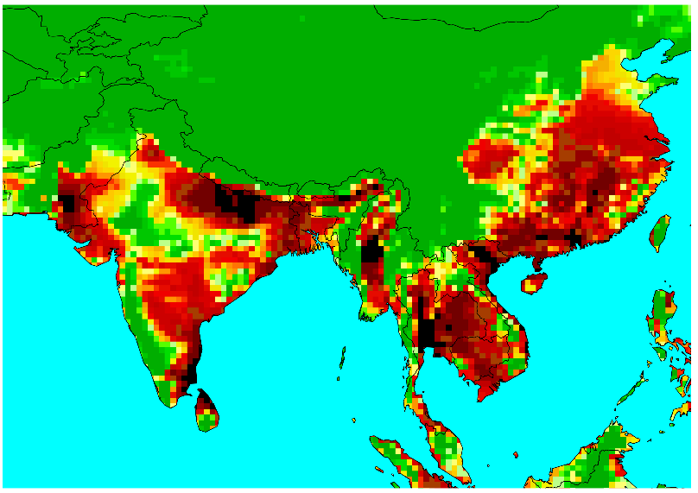
No. days where HImax(shade)>42C
1995
2085
Number of July days where HImax (shade) >42C = ACGIH Danger. GFDL model rcp 6.0
1995
2085

Slide 41
Who is already there?
Number of days per year where 300W outdoor work should be reduced from 8 hours per day due to heat, increases this century in these cities:
City | 1995 | 2085
Saskatoon | 2 | 10
Chicago | 20 | 45
Dallas | 118 | 150
Bangkok | 333 | 355
Kuala Lumpur | 361 | 365

Slide 42
Climatechip.org
Online climate predictions in 0.5X0.5 degree resolution.
www.climatechip.org

Slide 43
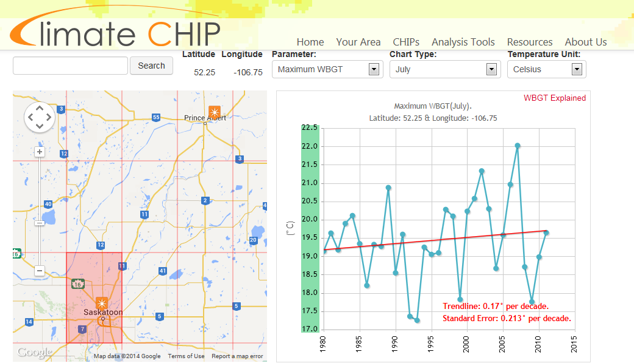
www.climatechip.org

Slide 44

www.climatechip.org
Today Tomorrow

Slide 45

Comparing Nth America & South Asia
What can we learn from each other?
How do you deal with heat stress now?
Water, clothes, work intensity, rest space, a/c
Advantages vs Disadvantages
Health factors vs Productivity loss
Self pacing (Rowlinson: construction industry example – Hong Kong 2014)
Notes:
Ann. Occup. Hyg., 2014, Vol. 58, No. 3, 326–339 Application of the Predicted Heat Strain Model in Development of Localized, Threshold-based Heat Stress Management Guidelines for the Construction Industry Steve Rowlinson and Yunyan Andrea Jia.

Slide 46
Thank You
Take home:
  Climate change will adversely affect the health and/or productivity of rural regions
  Cooler regions can learn from hotter regions
  Hothaps is designed to facilitate sharing of knowledge on heat stress and its mitigation
  Climatechip.org is a way of getting involved with the world-wide collaborative Hothaps program.
Notes:
www.climatechip.org

