Slide 1

Heat Stress in USA
Now & in the Future
Extended version

Slide 2
Heat Stress in USA: Why study USA?
Have studied India and SE Asia
  Extensive period of heat with little variation
  Significant reduction in work capacity
    eg Thailand 2050: 50% loss of afternoon work time in shade
    Kjellstrom T, Lemke B, Nag PK, Nuntavarn V-V, Uma SL, Sasitorn T (2013) “Increasing heat stress in occupational health due to climate change: Needs for research & prevention in South-East Asia” Industrial Health 2013 (in press).

Slide 3
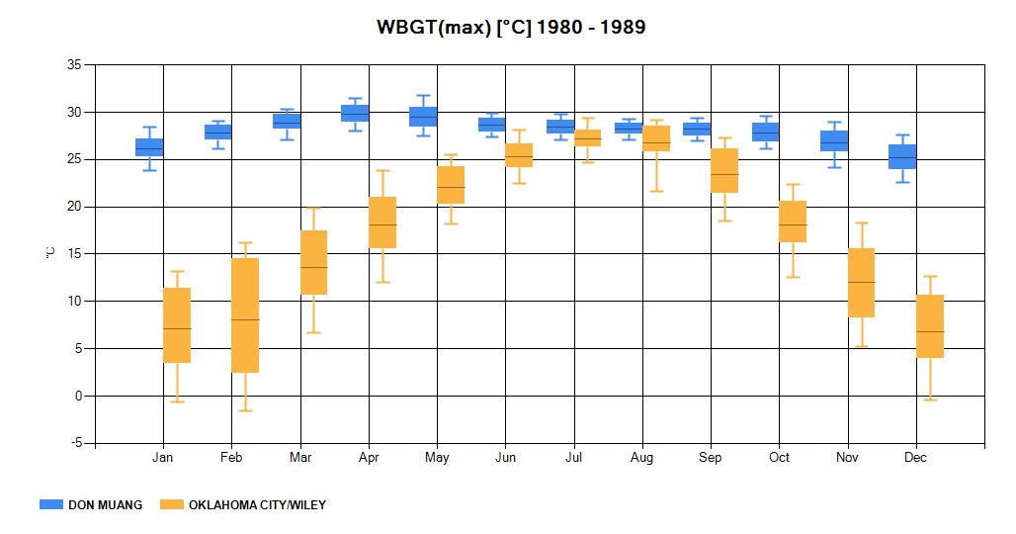
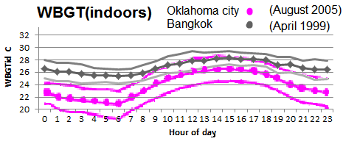
Heat Stress in USA: Why study USA?
Daily, monthly & yearly temperatures vary much more in temperate zones than in the tropics:
Similar productivity loss in temperate climate?
  Heaps of data from USA!

Slide 4
Heat Stress in USA: What is heat stress?
Over 34C, only way to loose heat generated by work is by evaporation of sweat
Evaporation is inhibited when humidity is high
  Example: 34C @ 80% humidity:
  maximum evaporative cooling rate is 180W
  Reference: Paul Uno ACI Materials Journal p365-375 July-August 1998
  Moderate work generates 300W
  = rise in core temperature (of about 1.5C per hour)

Slide 5
Measuring heat stress
To measure heat stress at given work rate:
need temperature, humidity, wind & solar.
Assume minimum clothes worn.

Slide 6
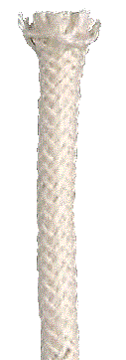

What heat stress index?
WBGT: For heat stress only.
  compiled by measurement on US military
  ISO standard for reduction in work time
  Simple: WBGT = 0.7Tw + 0.3Ta (in shade)
UTCI: Physiologically derived
  hard to measure at workplace, subjective scale
HI: USA meteorological use
  empirical formula, subjective scale

Slide 7
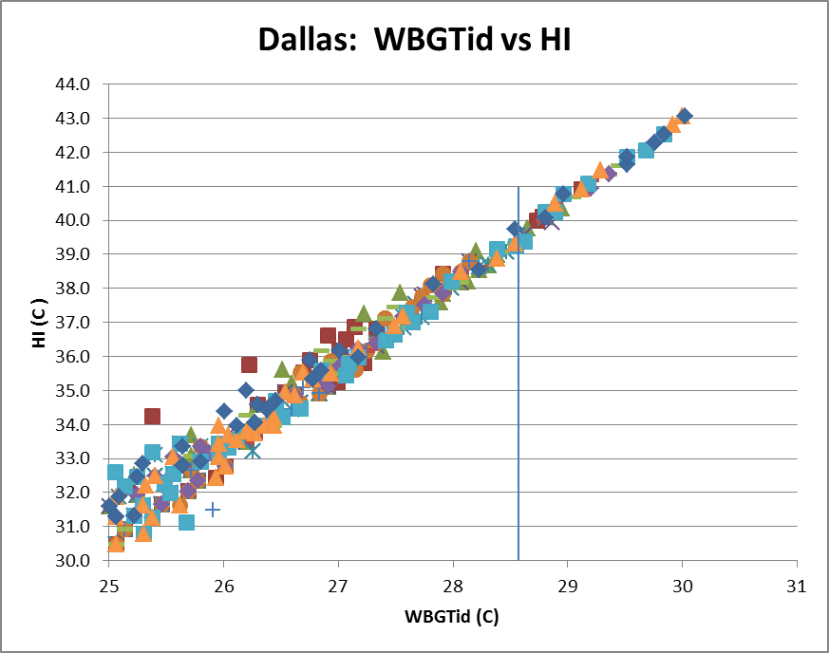
How do heat indexes compare?

Slide 8
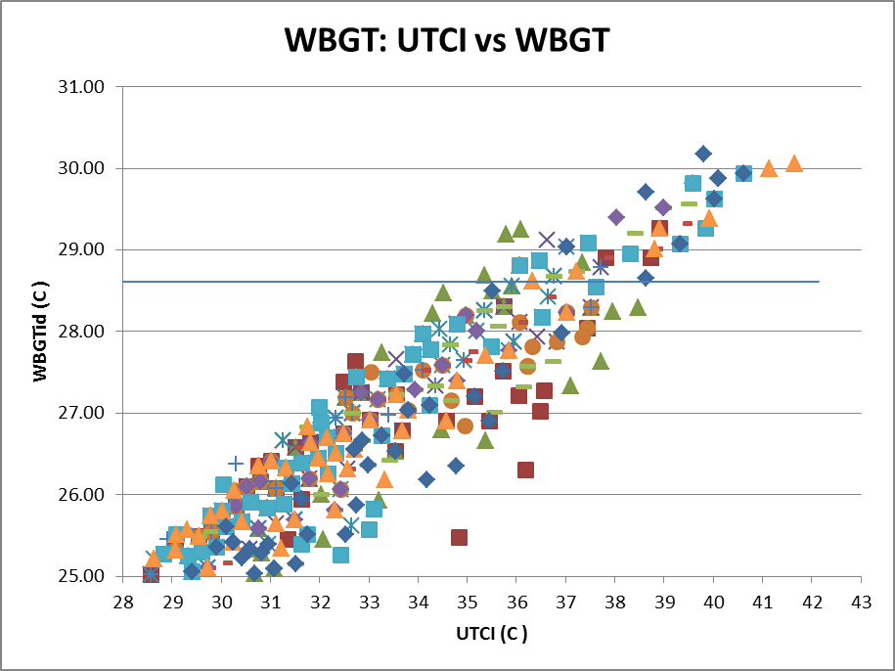
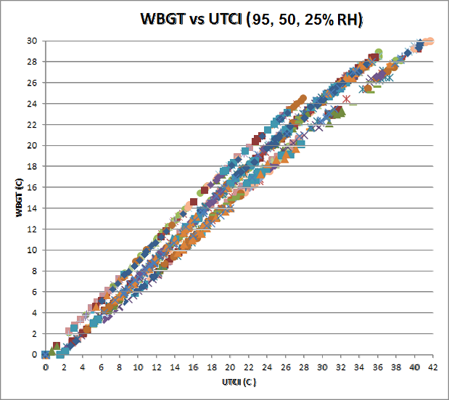
How do they compare?
Dallas: August 2005

Slide 9
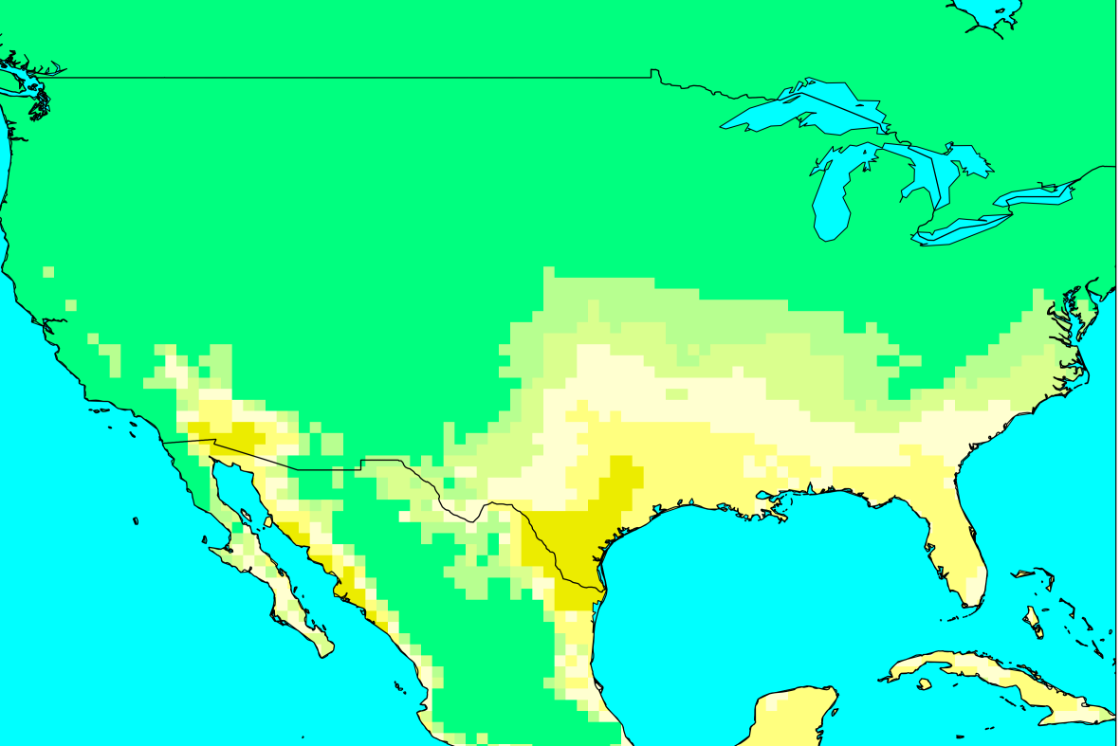
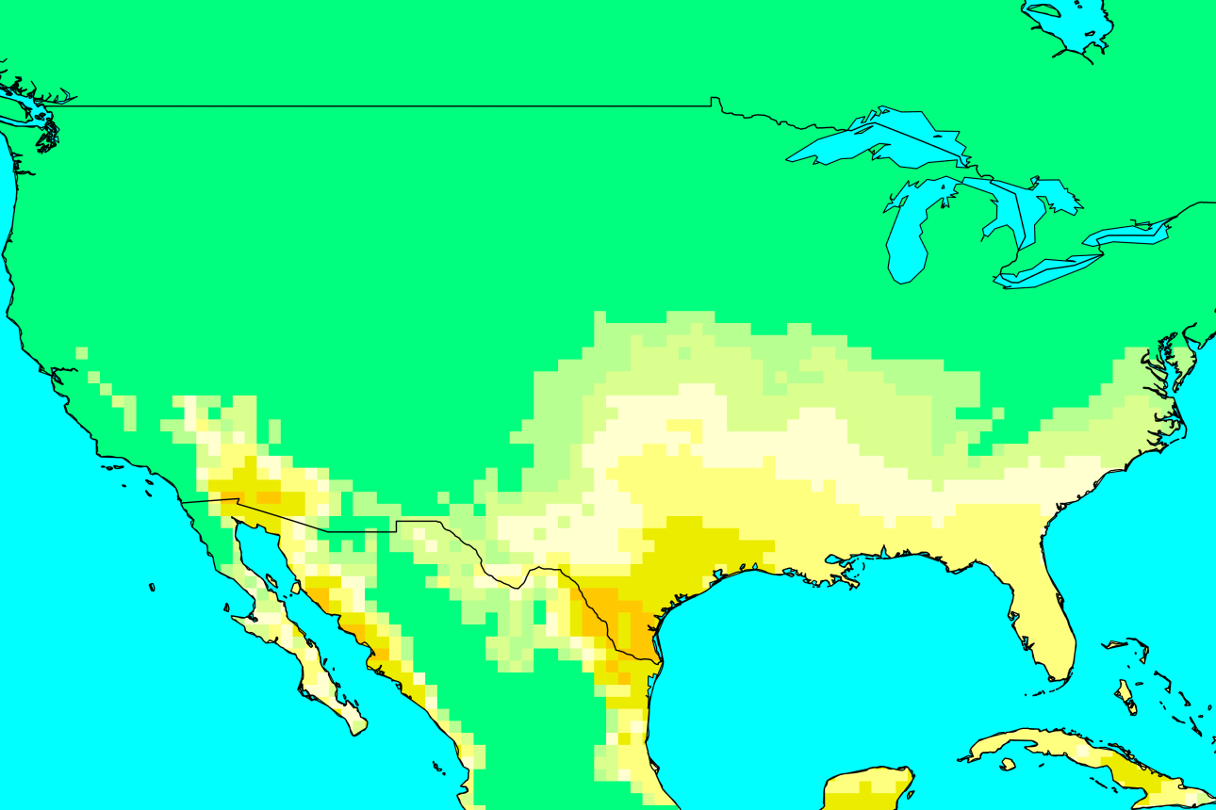
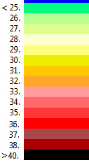
Results: WBGTshade 1975 & 2005
←1975 (30 yr ave)
August afternoon
↓2005 (30 yr ave)

Slide 10
How to get WBGT in sun
Calculate WBGT in shade and in sun for weather stations across country.
WBGTsun 2.2 to 2.8 C higher than WBGTshade from hourly data for a number of stations.
Average = 2.5 C higher
  Ibid: Kjellstrom et al Industrial Health 2013

Slide 11
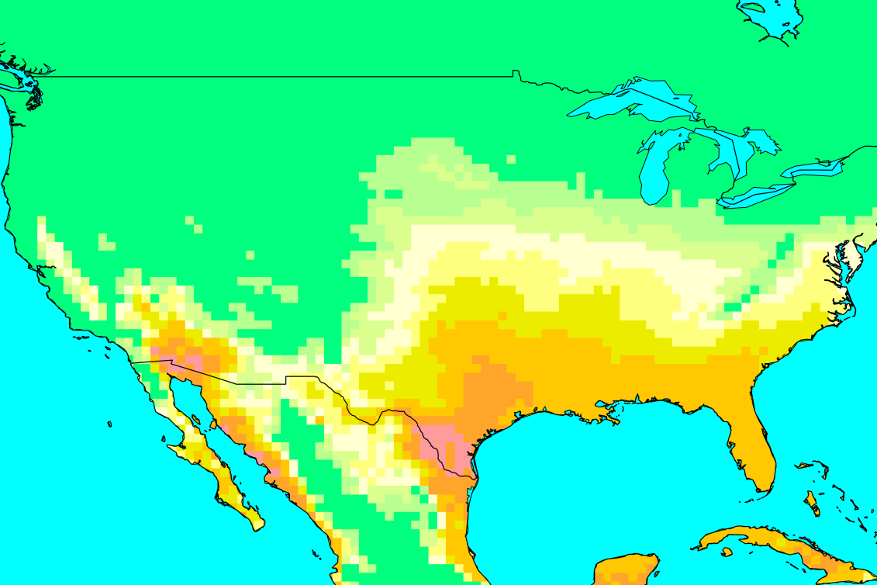
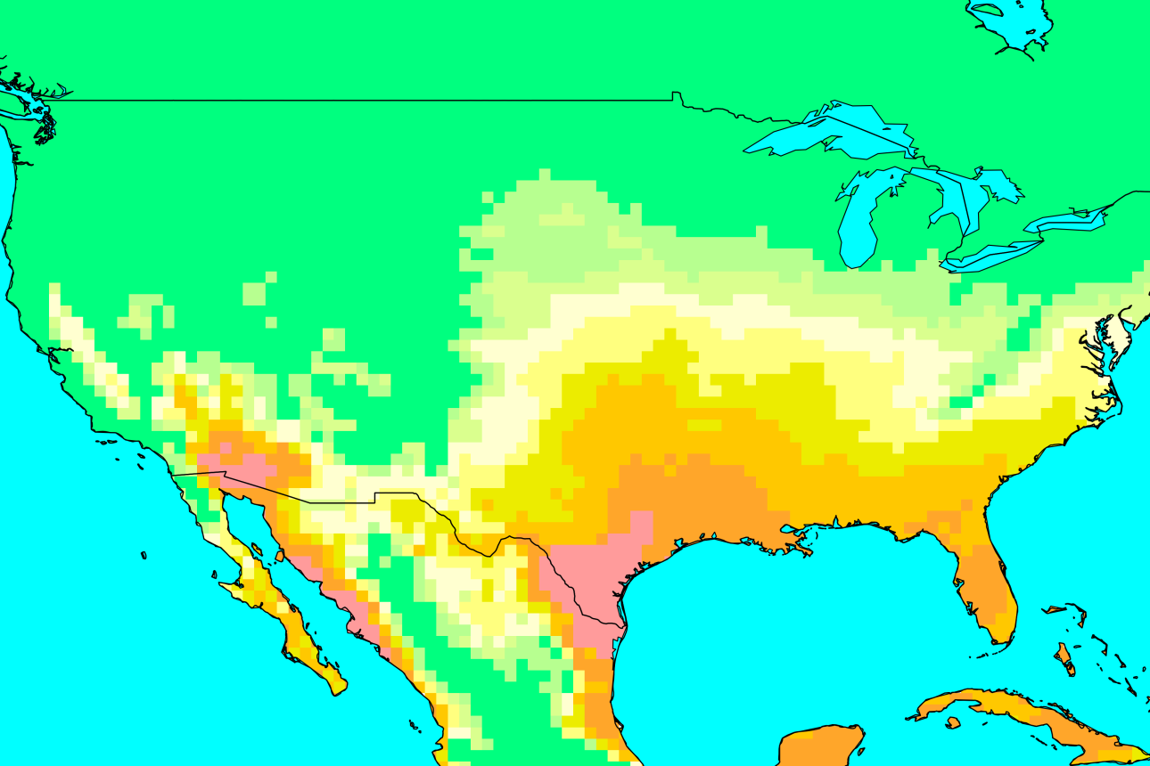
Results: WBGTsun 1975 & 2005
←1975 (30 yr ave)
August afternoon
↓2005 (30 yr ave)

Slide 12
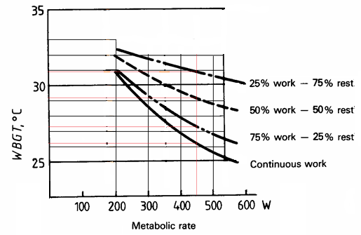
What does this mean for workers
ISO standard 7243 (recommended by NIOSH) for acclimatised workers
  www.cdc.gov/niosh/topics/heatstress/

Slide 13
What does this mean for workers
ISO standard 7243 (recommended by NIOSH) for moderate (300W) work (acclimatised)
  Continuous work till WBGT = 28.6
  15 min rest per hour till WBGT = 29.3
  30 min rest per hour till WBGT = 30.6
  45 min rest per hour till WBGT = 31.8
  no work at WBGT over this.
So change scale accordingly:

Slide 14
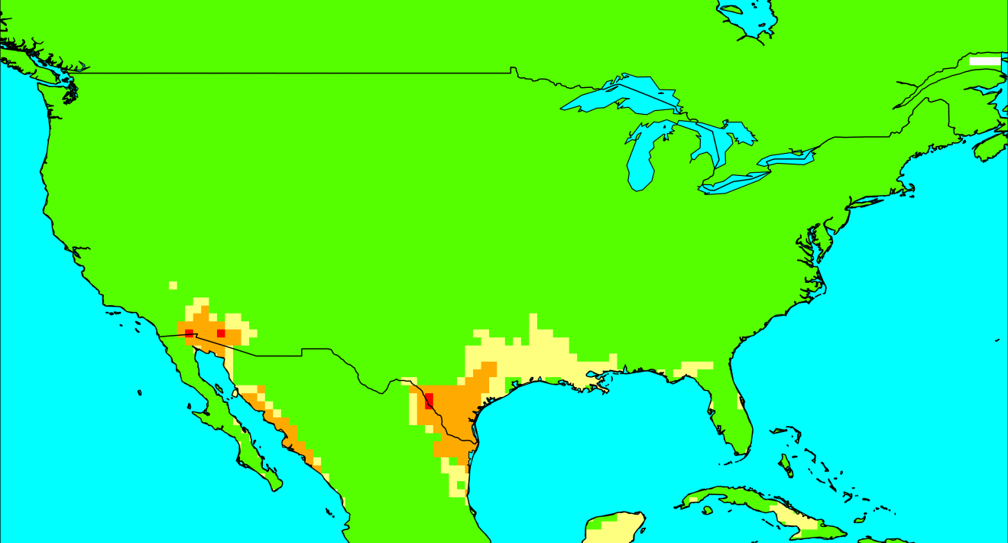
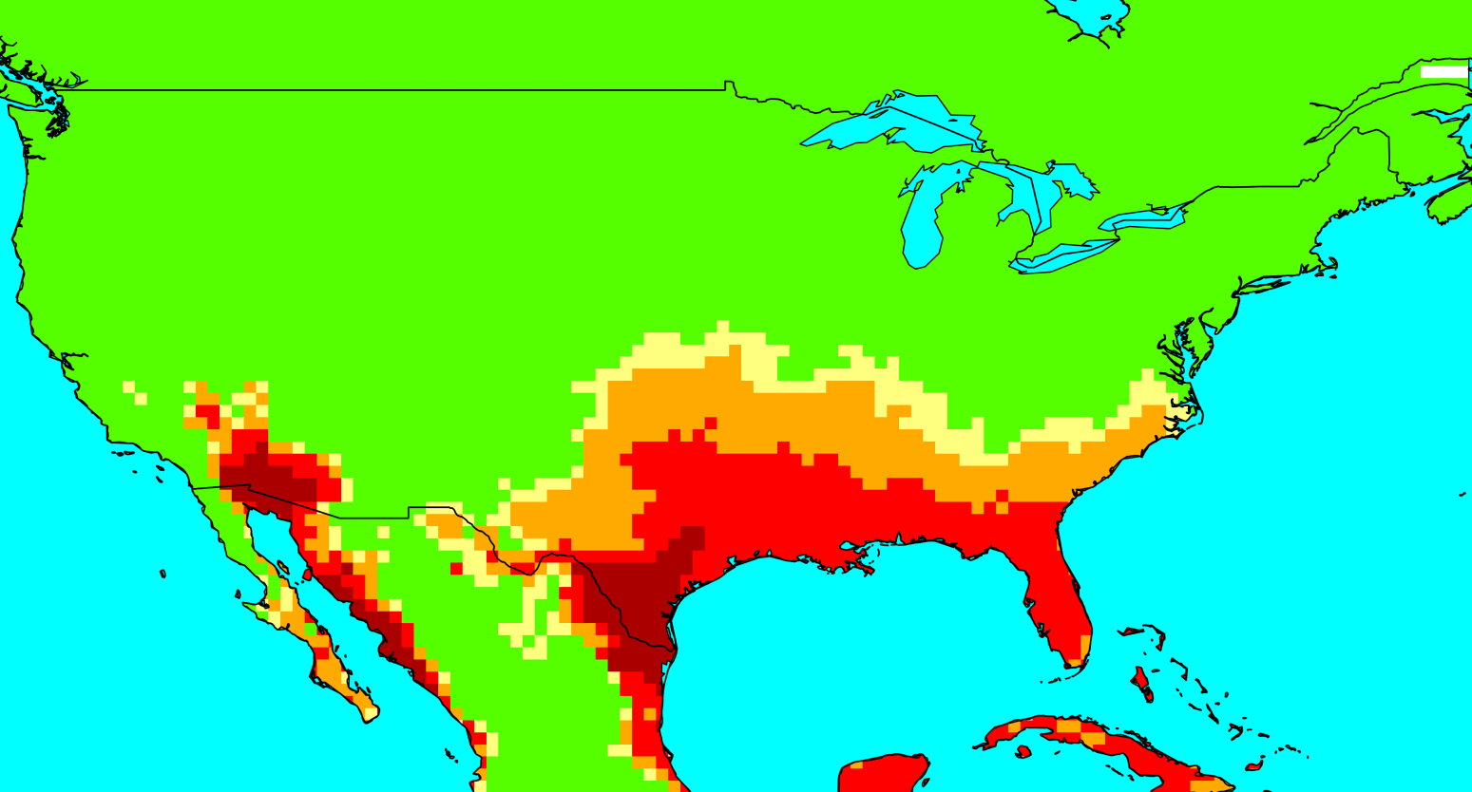

Results: 2000 WBGT shade & sun
←Shade (30 yr ave)
August afternoon
↓Sun (30 yr ave)

Slide 15
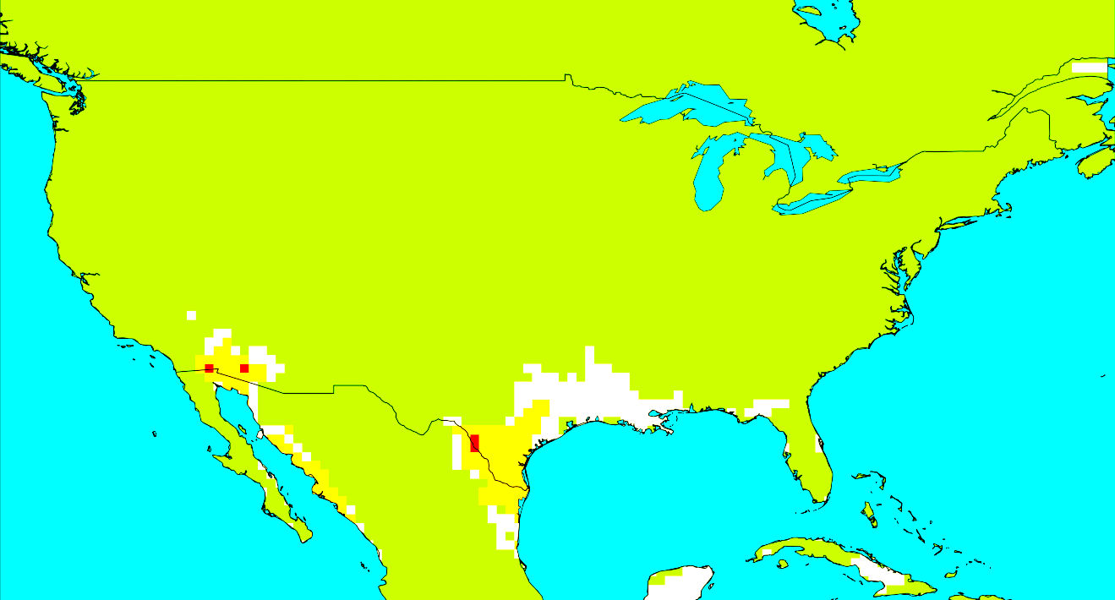
What monthly WBGT doesn’t show
Why can you work outdoors in shade continuously in August in most parts of USA?
  These are monthly averages so
  cold days cancel out hot days
How do we get the hottest week when gridded data only has monthly averages?

Slide 16
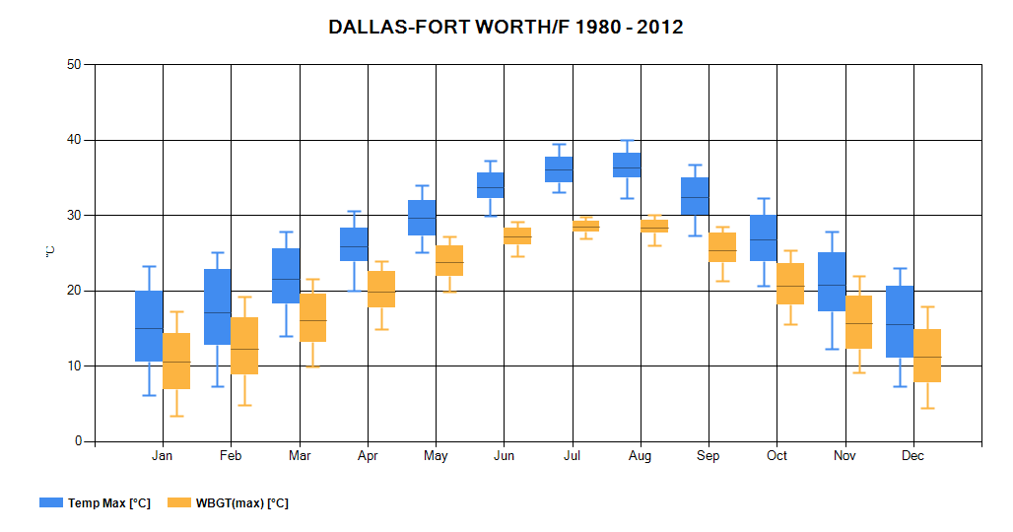
How we get hottest day/week
From a monthly WBGT profile for no. of cities we calculate WBGT(75%) – WBGT(median).
75Percentile temperature =hottest week

Slide 17
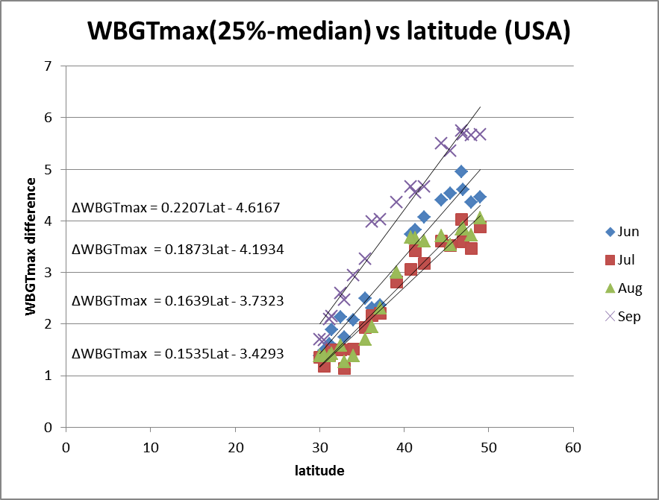
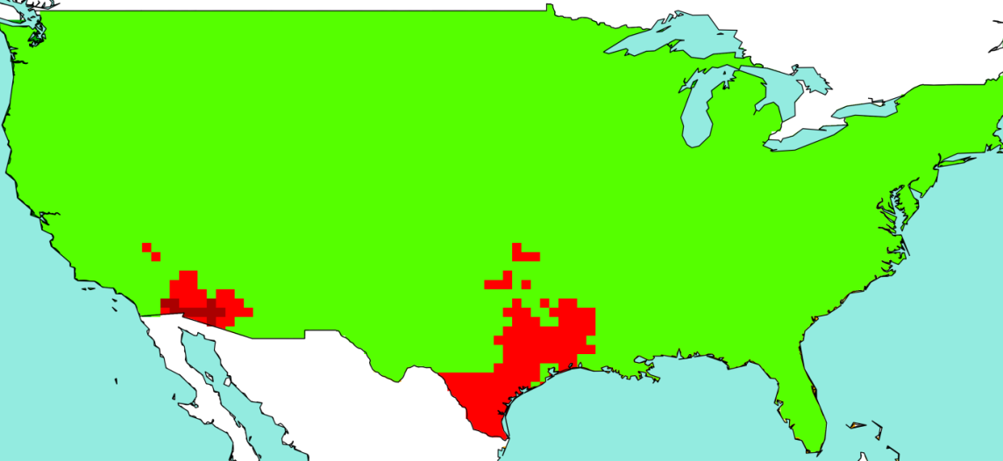
Hottest week
Plot and derive equation for: latitude vs WBGT_{max}(25%) – WBGT_{max}(median)

Slide 18
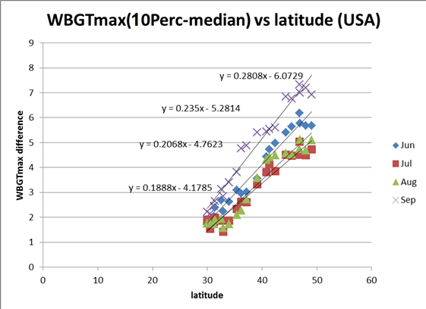
Hottest 3 days
Plot and derive equation for: latitude vs WBGT_{max}(10%)– WBGT_{max}(median)

Slide 19
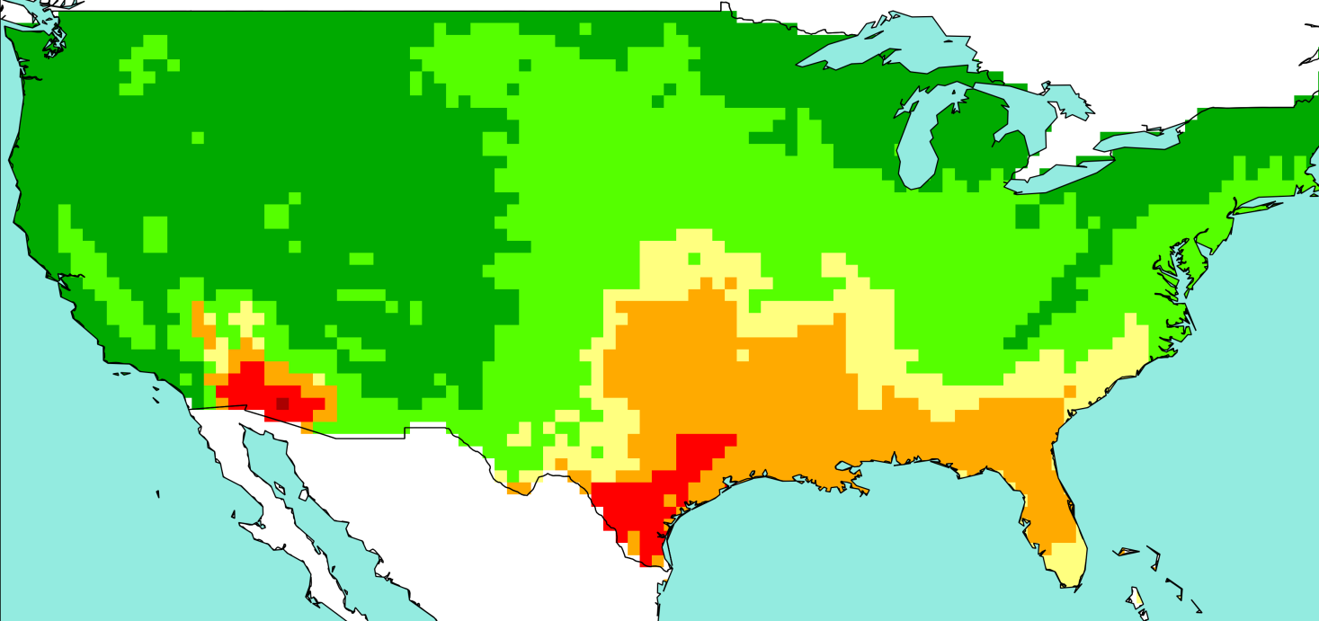
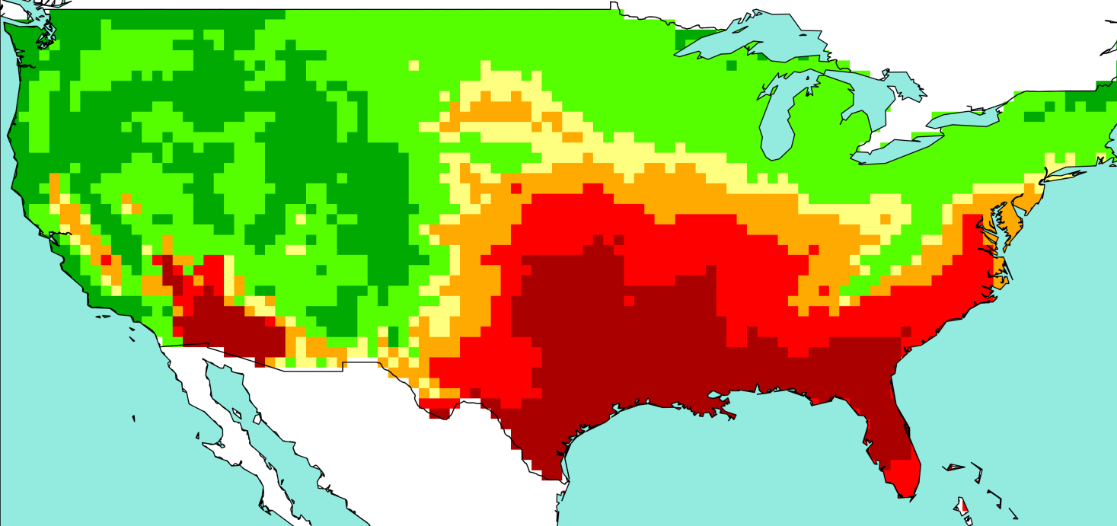
Results (hottest week): August2005 WBGT
←Shade (30 yr ave)
August
↓Sun (30 yr ave)

Slide 20
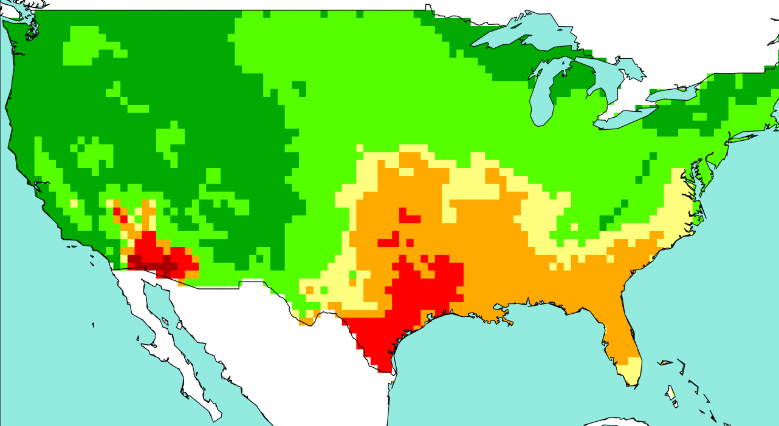
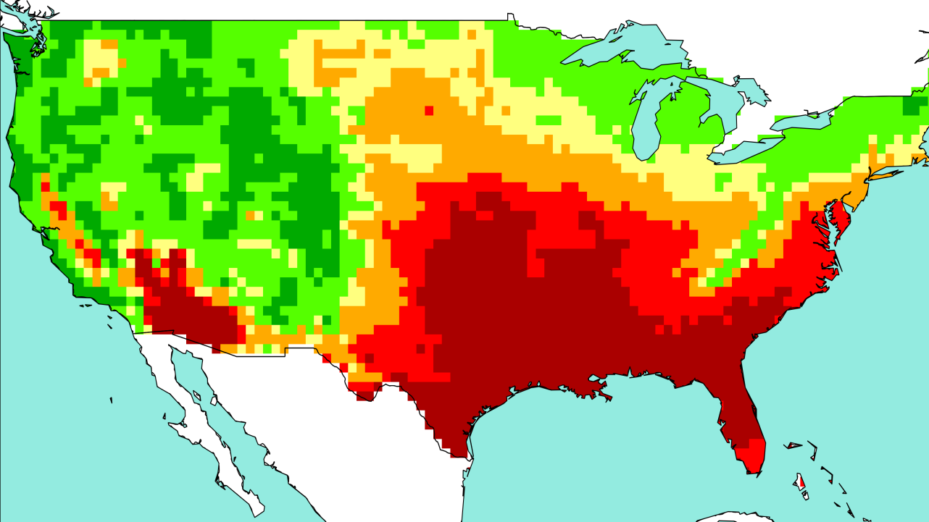
Results (hottest 3days): August2005 WBGT
←Shade (30 yr ave)
August
↓Sun (30 yr ave)

Slide 21
How we get future heat stress
Using GCM climate model projections
Three tested from Ensembles project (only ones with humidity)
  EGMAM (Germany)
  BCM2 (Norway)
  IPCM4 (France)
    BCM2 gave the least increase (2C/century)
    Used A1B scenario = emissions similar to RCP8.5

Slide 22
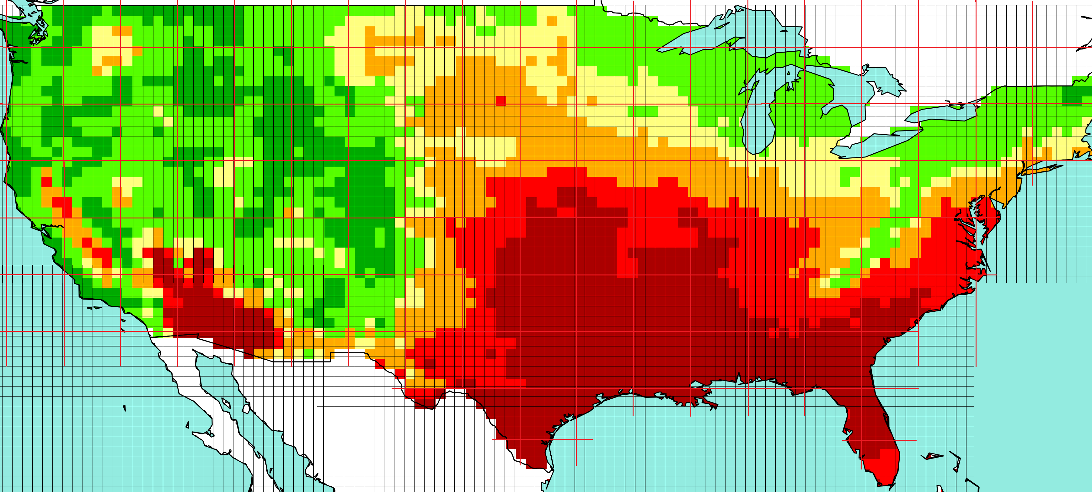
How we get future heat stress
GCMs are 2 degree or 3 degree resolution.
Use field change on gridded 50kmX50km data.

Slide 23
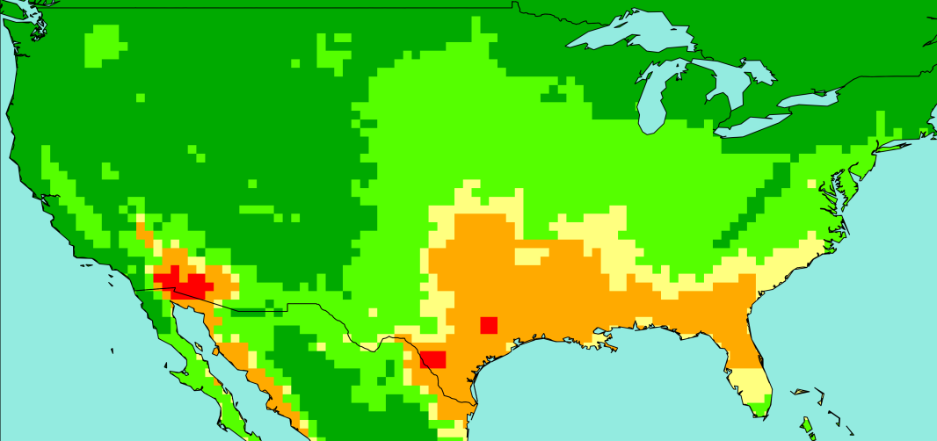
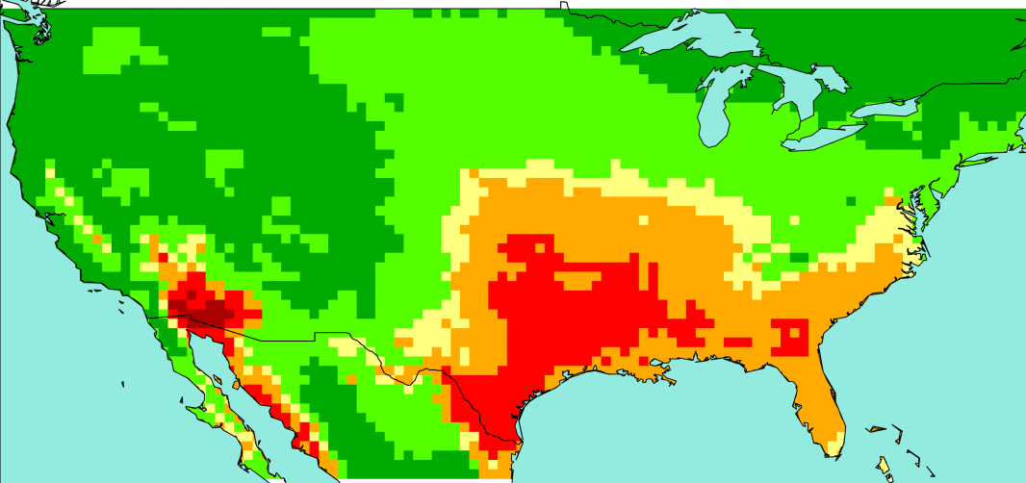
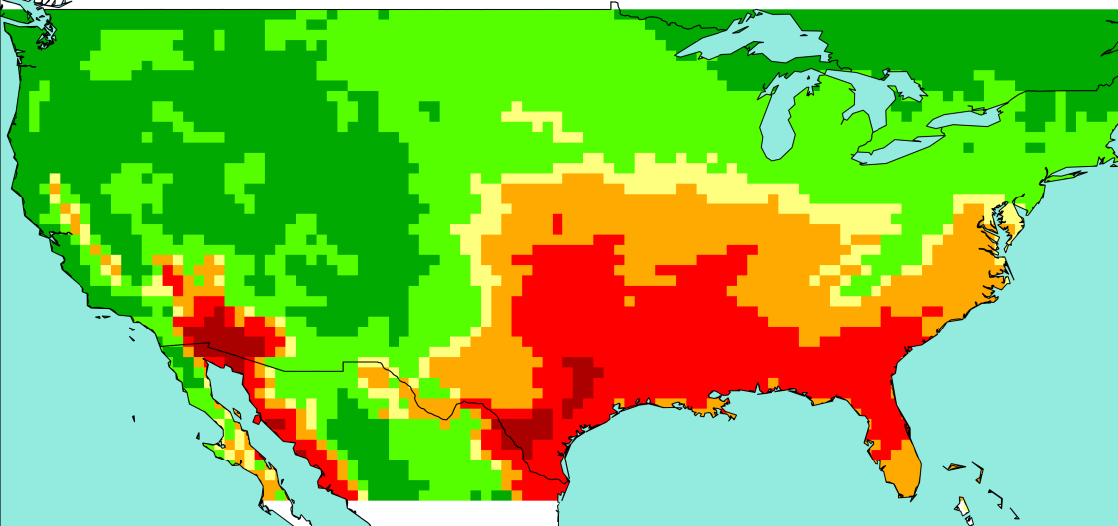
Results (week): WBGTshade 2030 & 2050
←1975 (30 yr ave)
August
↓2030 (30 yr ave)
2050 ↓

Slide 24
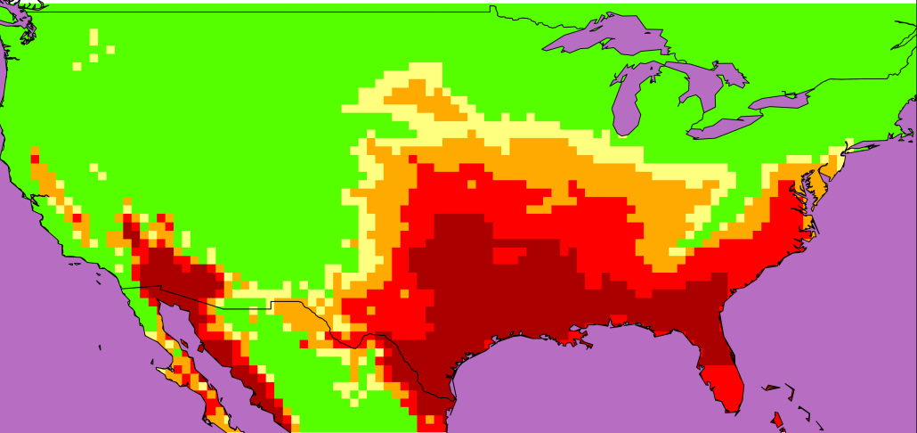
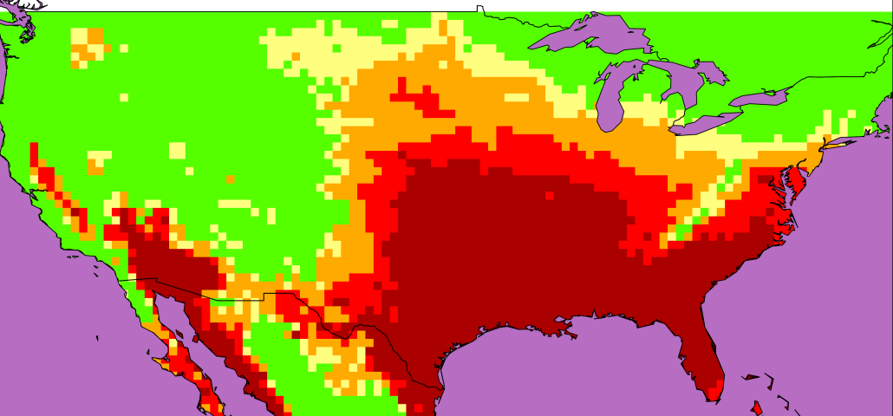
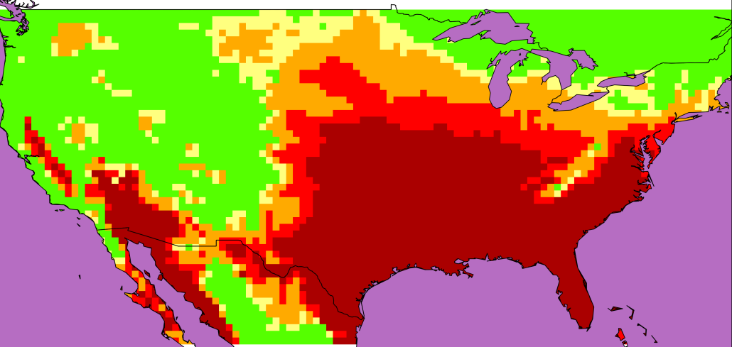
Results (week): WBGTsun 2030 & 2050
←1975 (30 yr ave)
August
↓2030 (30 yr ave)
2050 ↓

Slide 25
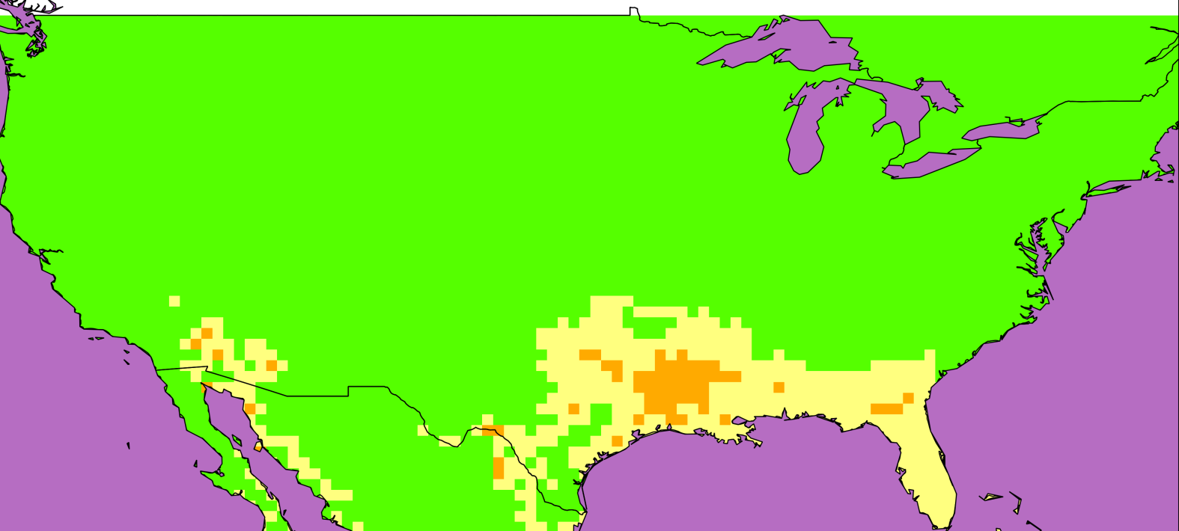
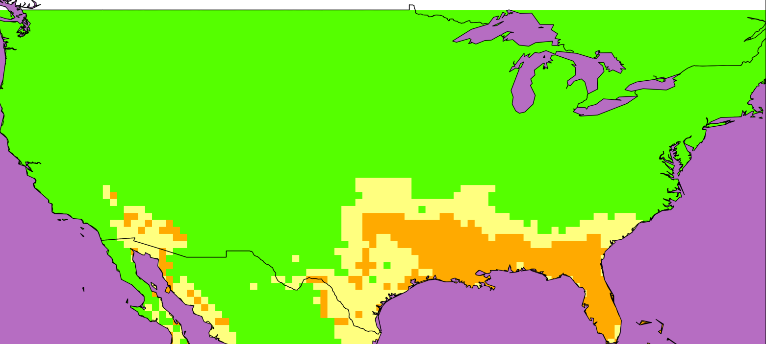
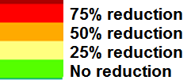
August Worktime reduction (shade)
←2030-1975
August average
↓2050-1975

Slide 26
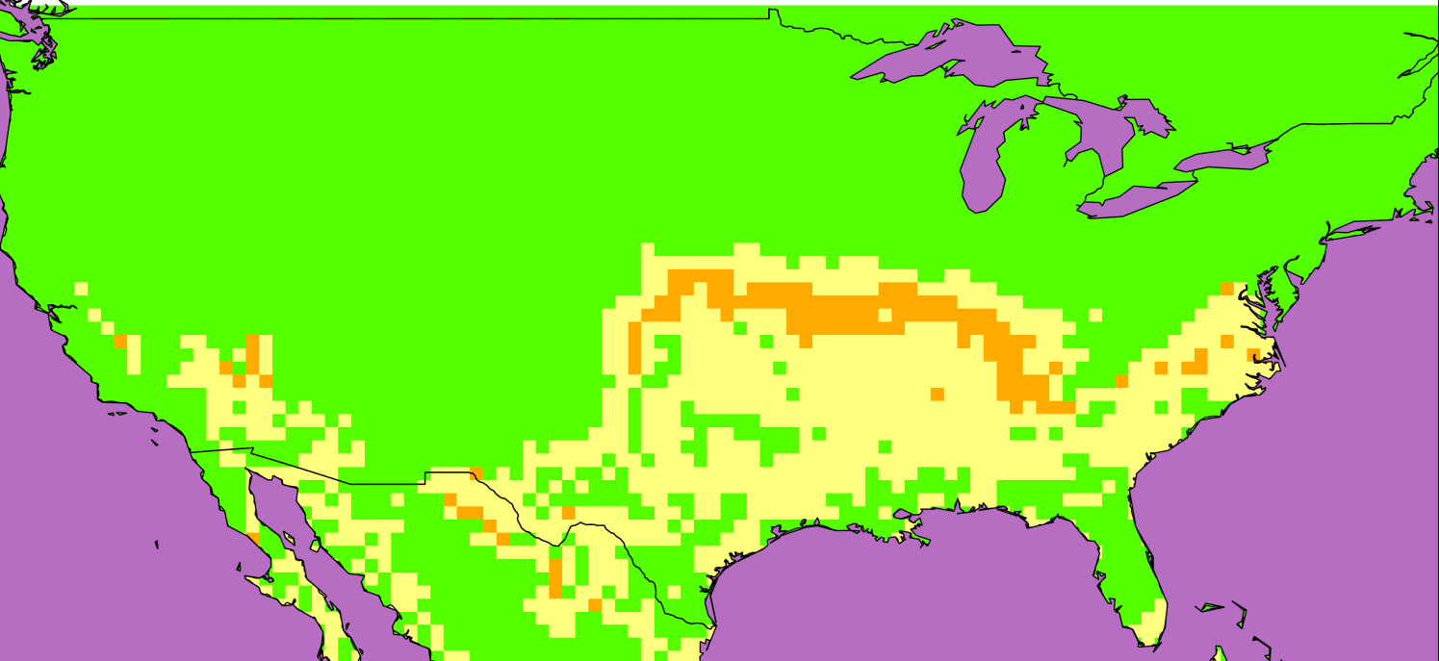
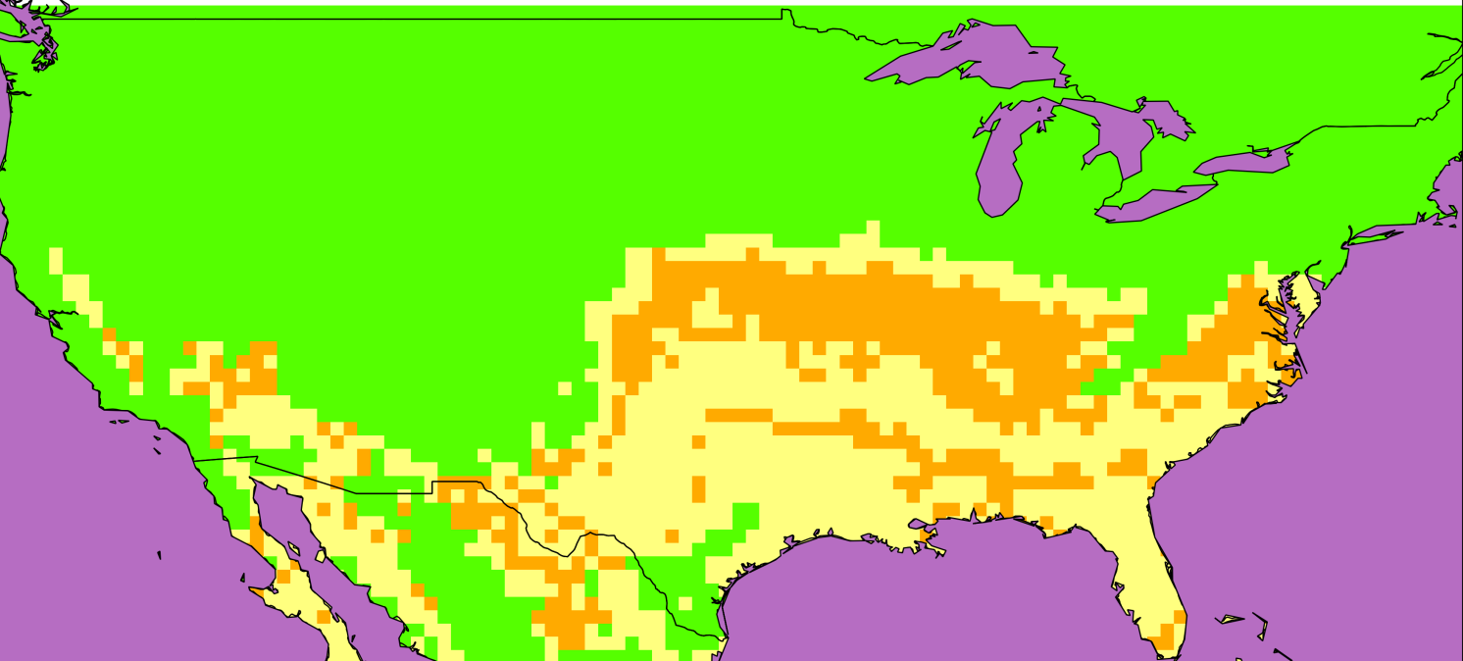
August Worktime reduction (sun)
←2030-1975
August average
↓2050-1975

Slide 27
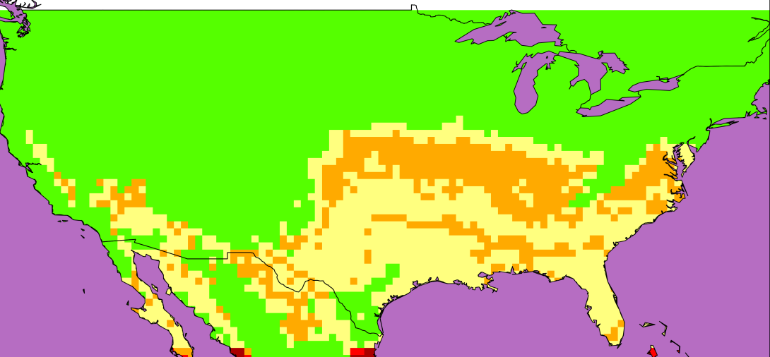
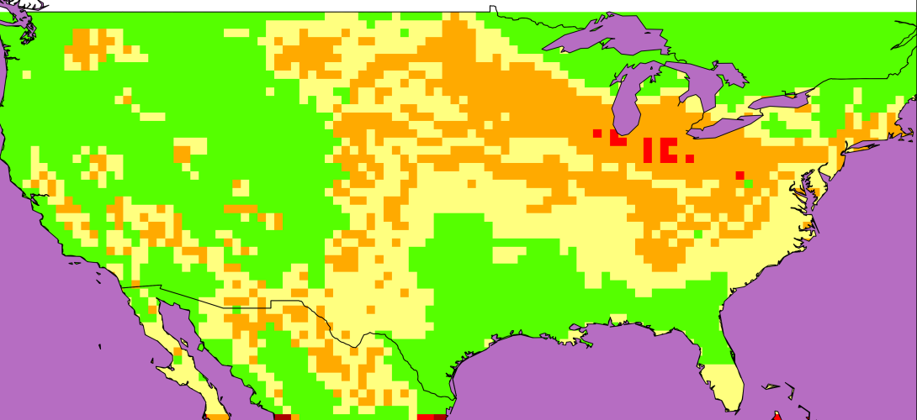
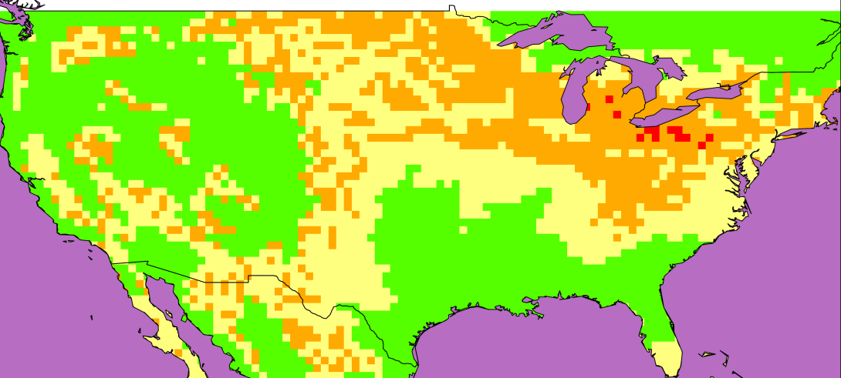
August worktime reduction 2050-1975: sun
←Hottest month
(August)
↓Hottest week
Hottest 3
days ↓

Slide 28
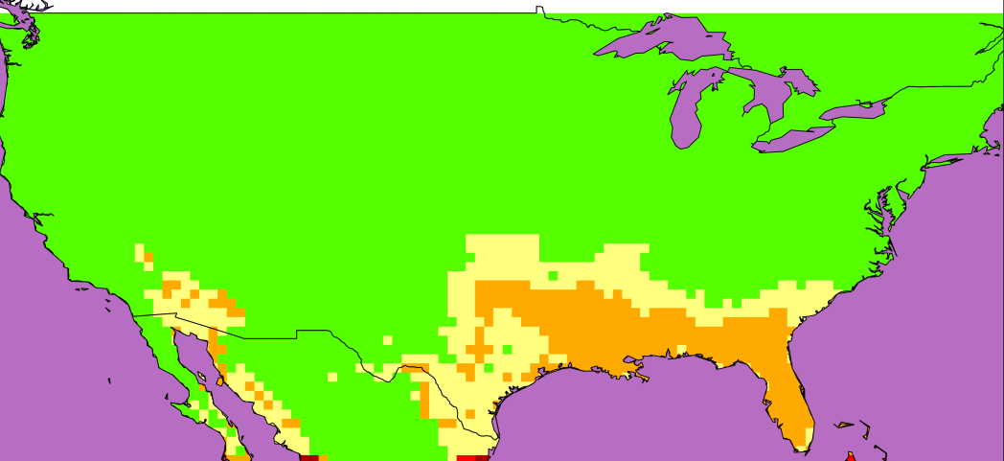
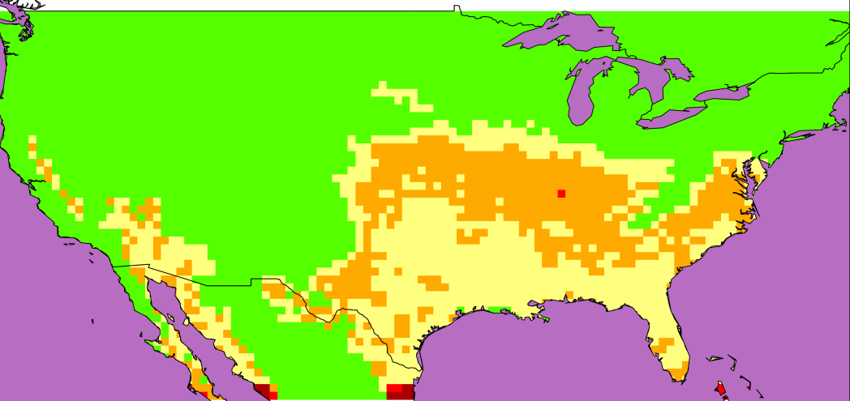
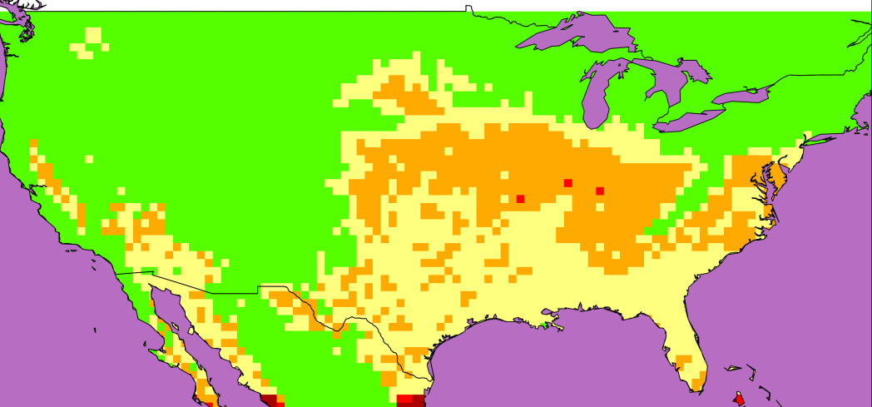
August worktime reduct^{n} 2050-1975: shade
←Hottest month
(August)
↓Hottest week
Hottest 3
days ↓

Slide 29
How much will this cost?
DARA report = $2.3 trillion by 2030
    http://daraint.org/climate-vulnerability-monitor/climate-vulnerability-monitor-2012/
Adaption will almost certainly occur
  siesta, air conditioning, mechanisation
  (more flexibility in non-tropical countries)
How far can we adapt?
  Higher humidity at night and morning
  Unsociable hours
  Cost of air conditioning ($ and energy use)

Slide 30
Conclusions
Method of using grid based monthly average data to estimate the work time loss, works in temperate zone countries as well as tropical countries.

Slide 31
Conclusions
Due to global warming, by 2050 we predict:
Southern USA: 25%-50% reduction in afternoon work outdoors (in shade) in August
Southern & mid USA: 25%-50% reduction in afternoon work outdoors (in sun) in August
Central & North east USA: 25%-50% reduction in afternoon work outdoors (in sun) in hottest week in August

