Slide 1
Heat Stress Indices
HOTHAPS December 2011

Slide 2
Why does “everyone” use Ta?
In the ICB most speakers used Ta (air temperature) in discussing heat stress.
A few used WBGT, AT, UTCI
Why?

Slide 3
Why are heat stress indicies not used?
Unfamiliar
People understand temperature but not heat
Too complex
No one index suits all purposes
We argue
Some have a bad history
Eurocentric and USA-centric

Slide 4
Outline
What does a good heat index look like?
What are the alternatives:
  Choose a current index
    Modify WBGT
    Modify UTCI
    Use an alternative (AT)
  Use all current indexes
  Invent a new index

Slide 5
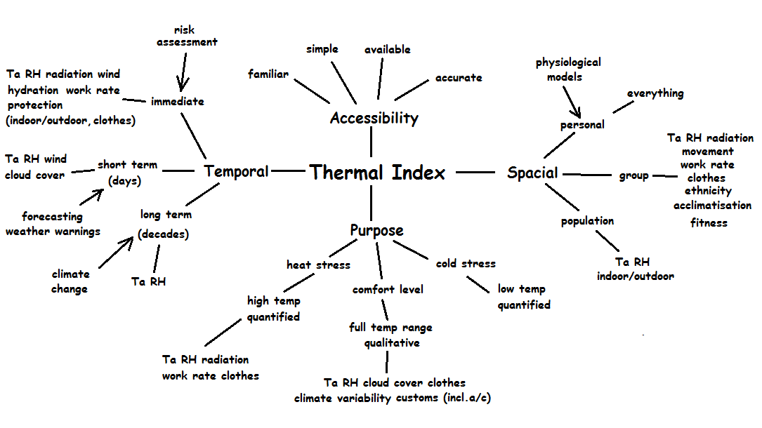

Slide 6
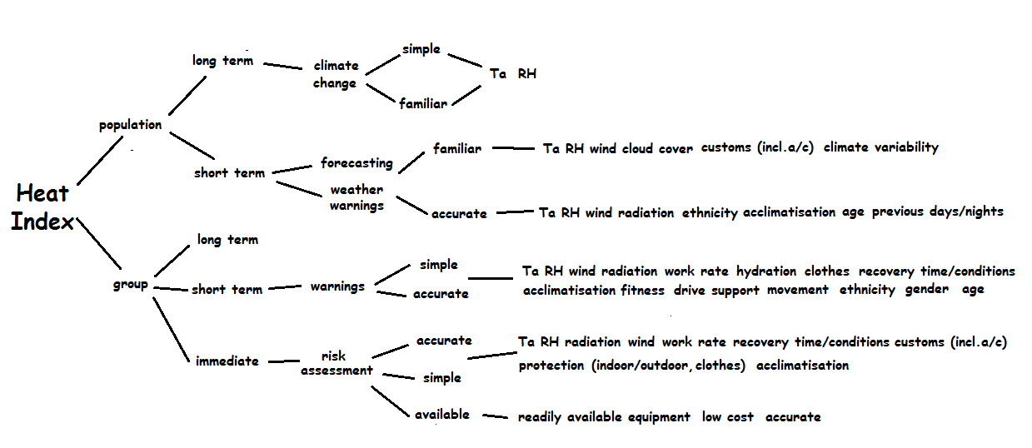

Slide 7
Using existing indexes: WBGT
Bad history (hasn’t met people’s needs)
Only works for heat stress (WBGT>25)
Can now be made “rational” (modelling similar to Fiala model)
Easy to measure
Lots of data
Most common
Simple

Slide 8
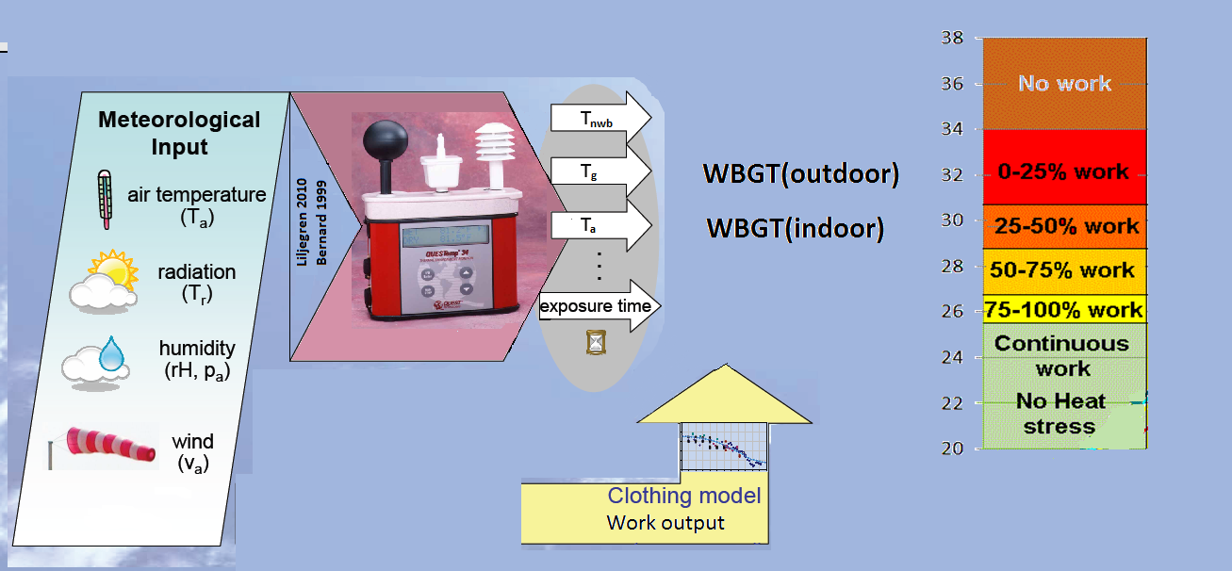
You can make any heat index rational
Same process as used by Fiala for people but its less complicated with objects.

Slide 9
Using existing indexes: UTCI
Complex “blackbox” = commercial
Uses Mean Radiant Temperature
Qualitative
Components (Ta, RH etc) interwoven
European
Scientifically sound
Accurate
Modifiable?

Slide 10
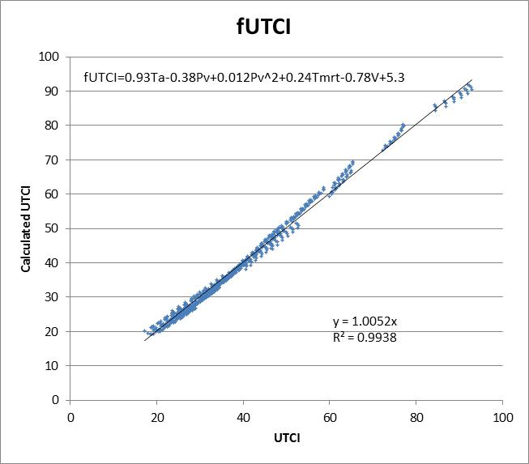

Slide 11
Removing MRT
fUTCI=
0.93Ta-0.38Pv+0.012Pv²+0.24Tmrt-0.78V+5.3
Tmrt = Tg - 1.82V^{½}(Tg-Ta) [approx]
Pv = 6.11exp(19.8 - 5418 / (Td + 273))
So we have a simple heat index based on science where all the components are identifiable and easily measurable.

Slide 12
Can we use all heat indexes?
Can reduce every heat index to its components
  except if it isn’t sensitive to one or the other.
We need to supply readily accessible conversions
We probably still need “one” main one.

Slide 13
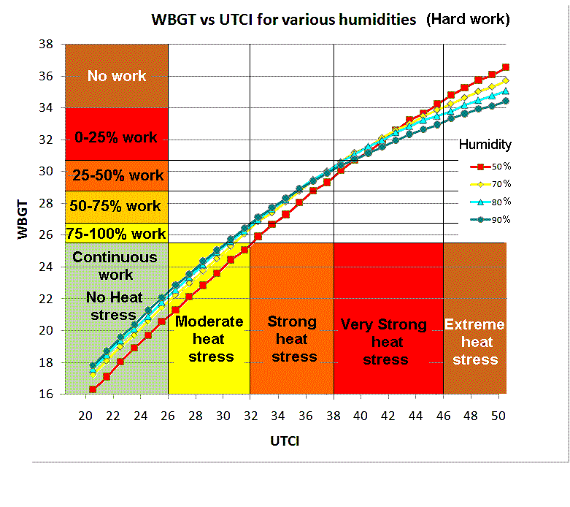
Notes:
ISO (1989) Hot environments - Estimation of the heat stress on working man, based on the WBGT-index (wet bulb globe temperature). ISO Standard 7243. International Standards Organization, Geneva.

Slide 14
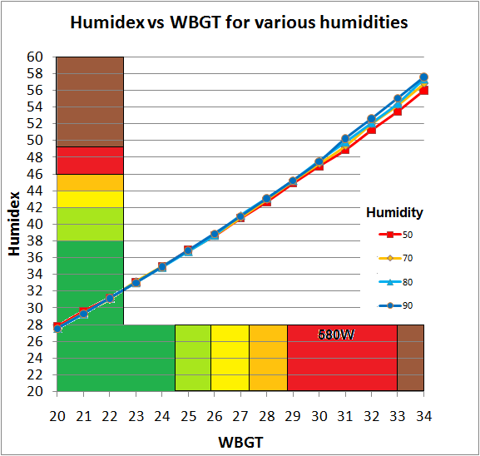
Continuous work 0-25% 25-50% 50-75% 75-100% no
rest rest rest rest work

Slide 15
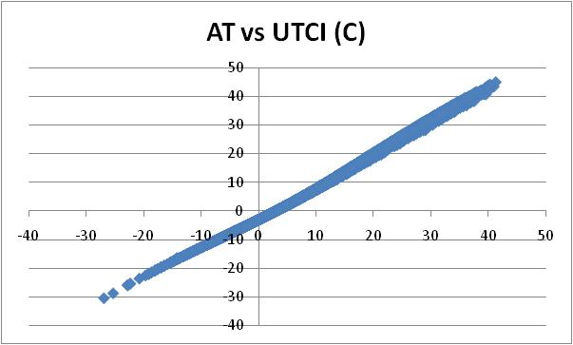
So why don’t we use AT?
AT
UTCI
Chicago 1999

